Slide 1
Memsad: why clearing memory is hard.
Ilja van Sprundel
<ivansprundel@IOActive.com>

Slide 2
whoami
17th congress in a row I’ve attended
Spoken at the congress before (21-24, 27, 30, 32, 34c3)
Work at IOActive (director of pentest)
We’re hiring ☺ come talk to me later.
Like low level stuff
Enjoy reading code (for fun and profit)

Slide 3
Who?
Audience
Security people
Crypto people
Code review people
Compiler people
Curious tech people
Knowledge level
Basic will do
Some C required
More advanced
As slides move on

Slide 4
What?
1 simple crypto implementation problem
Solutions aren’t that simple
lots of moving part to consider
Surprising amount of nuance
Notes:
Agenda:
Problem
Solutions
Real world data
!c
Related issues
Unexpected
Conclusion
Call to action

Slide 5
Why?
It’s –late- 2018, this is well known, wtf?
Because it’s still everywhere.
Conceptually known, sure. Practically, no!
foundations.

Slide 6
Giants
Standing on the shoulders of giants
Florian Weimer
Robert Seacord
Felix Von Leitner
Daniel Hodson
Ouzgar Kesim
David Wong
Colin Percival
...
Too many to list. Problem has been discussed before …

Slide 7
_start
Lets say you’re writing some code
And it’s handling sensitive data
E.g. keys, plaintext, sessiontokens, pwds, …
You’ll want to dispose of the sensitive data
Once you’re done with it
Why? Info leaks. Uninitialized data leaks.
think heartbleed.

Slide 8
code
int generate_key(unsigned char *key) {
unsigned char k[32];
read_rand(k, 32);
memcpy(key, k, 32);
memset(k, 0, 32);
return 0;
}

Slide 9
Problem?
Compile and run (add main()).
Does what it’s supposed to do.
Look at assembly, everything is fine
Now do –O1, -O2, -O3, -Os ….
Look at the assembly again

Slide 10
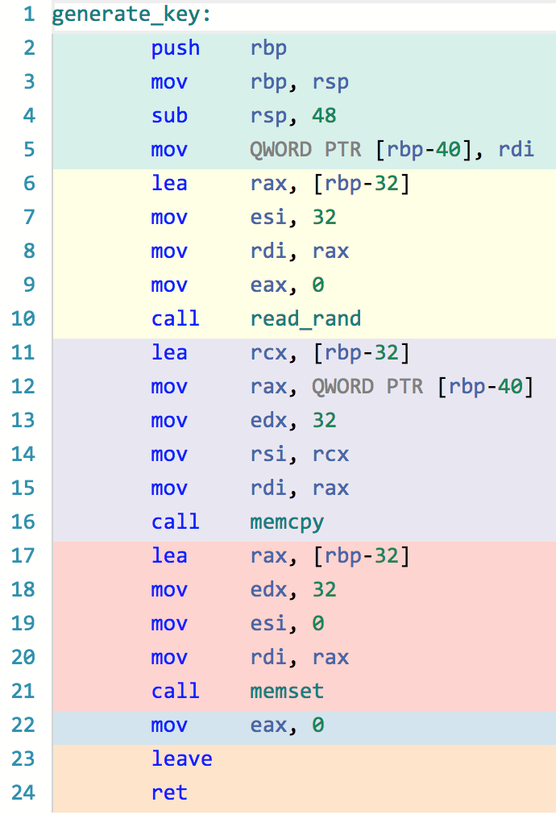
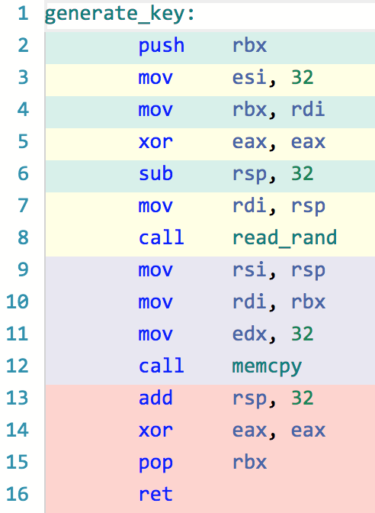
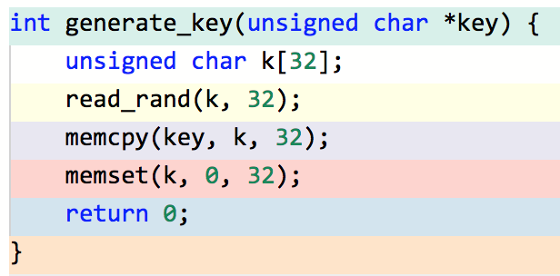
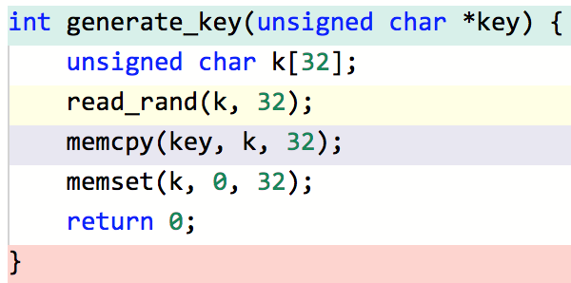
-O0
1
Problem!
Notes:
I nominate this slide for the “most animated slide” award ☺
Gcc 4.7.1
-fno-builtin-memcpy [for clarity]
First is default (-O0)
Second is –Os [optimize for small]
icc 13.0.1 -Os and -O1 if we replace memset() with zero copy loop

Slide 11
Compiler optimization
I would’ve gotten away with it too, if it wasn’t for those meddling optimizing compilers [and their dog!]
The memset at the end is called a dead store
You’re writing into something that is never going to get used again
According to the c standard the optimizer is allowed to get rid of it.

Slide 12
Tested compilers
many modern compilers can optimize out dead stores (twiddle with –O switches, replace memset with for loop)
gcc (versions on compiler explorer)
Clang (versions on compiler explorer)
icc (versions on compiler explorer)
msvc (versions on compiler explorer)
Oracle (former sun) studio (12.6)
PGI community edition (18.4) -Mdse
Embarcadero C++ builder (10.2) –Ob (yes with 64bit compiler)
Open Watcom 1.9
IAR 8.30
KEIL compiler MDK-Arm 5.26.2.0 (-Otime)
Notes:
Tried to get my hands on IBM XL and wind river diab. No luck.
Still need to test IAR and KEIL
Sun studio –O3 with 0clearing loop

Slide 13
Common?
Is compiler optimization actually in common use?
Some stats
Opensource.apple.com(10.13.6) > ~100/198
… wanted to get more, ran out of time / got bored …
IDEs
Visual studio release default is /O2 /Oi /GL
Xcode release default is –Os
YES! In common use. Not everywhere, but very common.
Notes:
Opensource.apple.com is a bit different, since it’s a relatively small set of ~200 applications. So I simply looked at all those to see how they’re compiled. (the number is actually higher, but due to implicit xcode –O settings its hard to nail down those numbers)

Slide 14
Solutions
There appear to be quite a few
Nothing really portable ☹
All solutions that work with
Particular compiler
Particular libc
Particular OS
Particular version of language
Particular executable file format

Slide 15
Solution: Roll your own
NEIN, DAS IST VERBOTEN!
Seriously, don’t Leeroy Jenkins this.
You’ll screw it up or do something ridiculous
Probably both
Chances are you’ll get away with it for <compiler><version> you’re testing with
But won’t work elsewhere
Or language lawyers will find a way to allow optimizing compilers to optimize it out in future versions

Slide 16
Solution: explicit_bzero
Guarantees it doesn’t get optimized out
Not standardized
Added in OpenBSD 5.5 (~may 2014)
NetBSD 7 has explicit_memset instead
Ported to FreeBSD 11 (~oct 2016)
Ported to glibc 2.25 (~feb 2017)
Currently not in OSX
Notes:
Also in LibreSSL
dietlibc also implements this

Slide 17
Solution: SecureZeroMemory
Windows only
From MSDN: “ensure that your data will be overwritten promptly”
Supported from XP and win2003 onwards

Slide 18
Solution: memset_s
Guarantees it doesn’t get optimized out
By spec
Standardized. But …
Is in C11 standard. YAY!
Optional Annex K. BOO! (boooourns?)
You can be C11 compliant and not offer memset_s

Slide 19
Solution: crypto lib APIs
if you’re doing crypto stuff there’s a decent chance you’re using a crypto lib
OPENSSL_cleanse – OpenSSL
gnutls_memset – GnuTLS
sodium_memzero –

Slide 20
Solution: -fno-builtin-memset
Tells compiler not to use internal memset
Compiler can no longer reason about what memset does
Gcc specific
Clang supports the command line switch too
Older versions (e.g. 3.7) drop it on the floor and ignore it (memset still gets optimized out).
icc supports this too
Need to change build environment

Slide 21
Solution: no optimization (global)
Per compiled object
Compile with –O0
No FORTIFY_SOURCE since it requires -01
Turns off optimization
Requires build environment tweaks
Not portable, but most compilers have something like it
May not be something you want in prod …
Notes:
Cause trouble with inlining ?

Slide 22
Solution: no optimization (local)
Some compilers allow devs to instruct compiler to not optimize specific pieces of code
MSVC: #pragma optimize (“”, off)
Gcc: #pragma GCC optimize (“O0”)
Notes:
https://stackoverflow.com/questions/5580140/is-there-a-way-to-tell-gcc-not-to-optimise-a-particular-piece-of-code
The gcc thing appears to be underused ??? Developer awareness ?
Looks like GCC one has limited scope. ← scope is limited to functions.

Slide 23
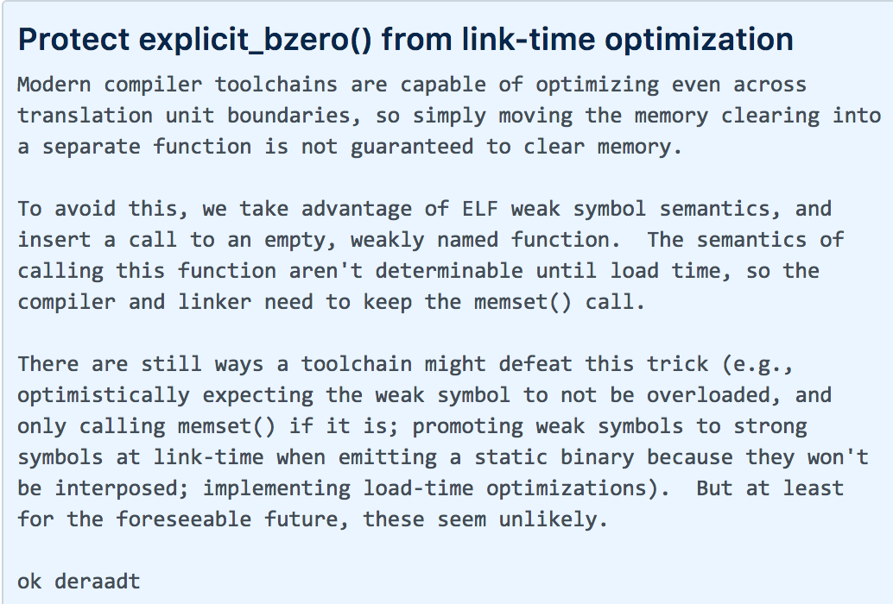
Solution: weak symbols
ELF specific. Can declare a symbol as ‘weak’
Marks symbols so it’s possible it can be overwritten later, in runtime.
Hard for compiler to reason about it now.
This is what OpenBSD uses in explicit_bzero
Is this bulletproof ?
Notes:
https://github.com/openbsd/src/commit/bdc0d3c99eecfcede64d62e0dabfb0d7270dd2b2#diff-3b44e4a2d5ebe017a0e7bf7b4c0f36a5

Slide 24
Solution: memory barrier
Barrier tells HW not to reorder memory accesses
Architecture specific set of instructions
Compiler will generate instructions needed.
Compiler directive for membars on most compilers
Not portable across compilers ☹
C11! atomic_signal_fence()
on top of generating code to inform HW, this also informs the optimizer!
“I know something about this memory you don’t. DO NOT TOUCH”
glibc, dietlibc use this when implementing explicit_bzero
Notes:
Memory barrier:
Pseudo code:
a = <value>;
b = <value>;
a and b seemingly have no relation. Nothing happens between the two
This means the compiler and the hardware are free to reorder those operation
Now assume the following code in another thread:
while(!b);
use(a);
Now you’ve defined a relationship between a and b (in the assumption that b will only ever be set _AFTER_ a is already set).
But the compiler nor the hardware are aware of this relationship.
This leads to narrow race conditions.
To solve this there is a thing called memory barriers. Code changes to:
a = <value>;
Memorybarrier();
b = <value>;
This code guarantees that the code above the barrier gets executed before the code below the barrier gets executed.
You’re telling the compiler and HW not to re-order those operations.
MSVC: _ReadBarrier / _WriteBarrier / _ReadWriteBarrier
https://gist.github.com/leo-yuriev/ba186a6bf5cf3a27bae7
Not portable, but most compilers have a way of doing memory barriers
C11 defines a way to do this:
atomic_thread_fence(memory_order_acq_rel);
Explanation in slide is more simplistic than reality. I make no distinction between compiler and hw BARRIER.

Slide 25
Solution: volatile
Fallback solutions
Best effort
Compilers could –technically- optimize out
But they’re not clever enough
And probably won’t be for the foreseeable future
Volatile pointer write
Libsodium fallback
Volatile function pointer to memset
Is what OPENSSL_cleanse uses
Notes:
See OpenBSD comment for weak symbols

Slide 26
Volatile pointer write
void
sodium_memzero(void *const pnt, const size_t len){
volatile unsigned char *volatile pnt_ =
(volatile unsigned char *volatile) pnt;
size_t i = (size_t) 0U;
while (i < len) {
pnt_[i++] = 0U;
}
}

Slide 27
Volatile function pointer to memset
typedef void *(*memset_t)(void *, int, size_t);
static volatile memset_t memset_func = memset;
void OPENSSL_cleanse(void *ptr, size_t len){
memset_func(ptr, 0, len);
}

Slide 28
Portable solution?
This is why clearing memory is hard!
Apply all of the above?
as best as possible
Look at libsodium.
sodium_memzero() has a large list of possible solutions that are all #ifdef’ed.

Slide 29
Compiler warning?
Detection is a solvable problem.
Compilers should tell us if they optimized out something with security consequences
None do as far as I can tell ☹ WHY?
Modified gcc to warn on dead store removal!
diff -r orig/gcc-7.4.0/gcc/tree-ssa-dse.c gcc-7.4.0/gcc/tree-ssa-dse.c
745c745,753
< delete_dead_call (gsi);
---
> {
> if (DECL_FUNCTION_CODE (gimple_call_fndecl (stmt)) == BUILT_IN_MEMSET)
> {
> char const *file = gimple_filename(stmt);
> int line_no = gimple_lineno(stmt);
> fprintf(stderr, "%s:%d: optimized out memset\n", file, line_no);
> }
> delete_dead_call (gsi);
> }

Slide 30
Compilefest ‘18
Downloaded a bunch of opensource software, and used the modified compiler

Slide 31
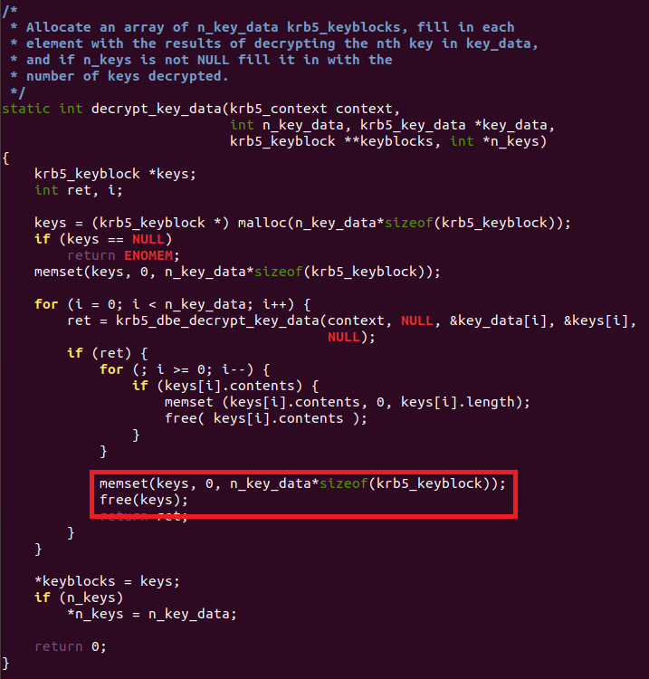
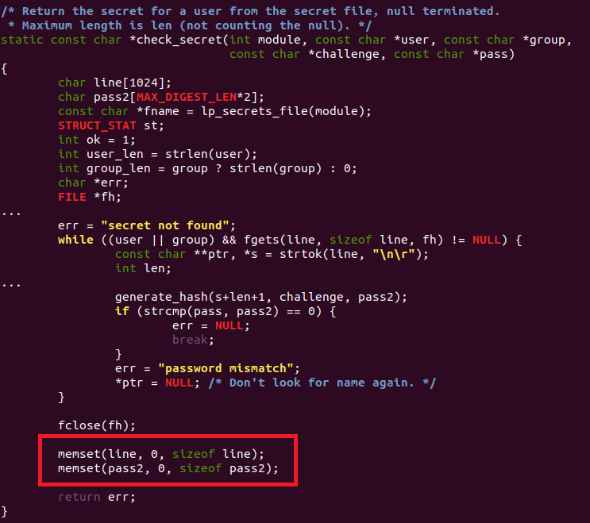
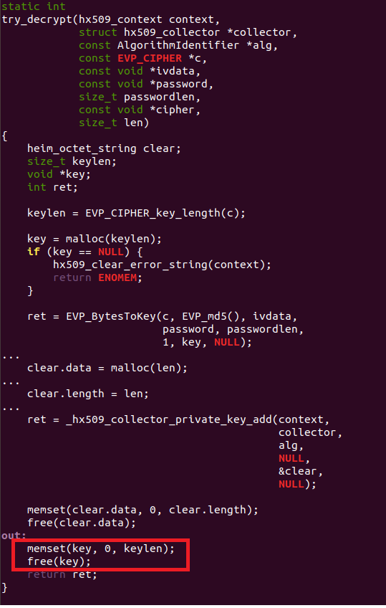
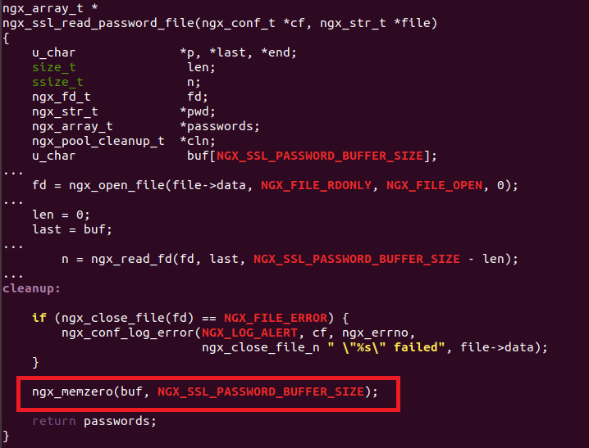
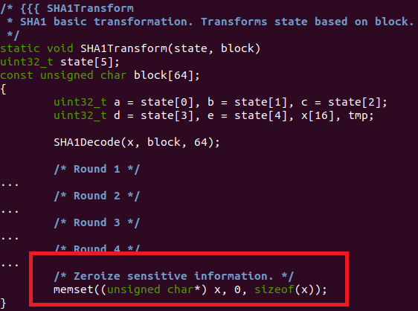
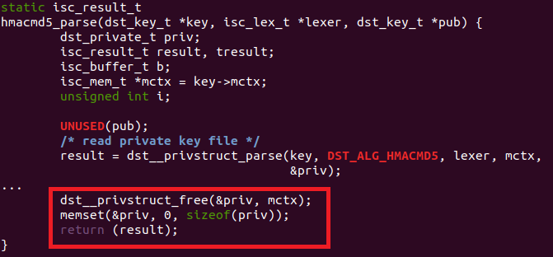
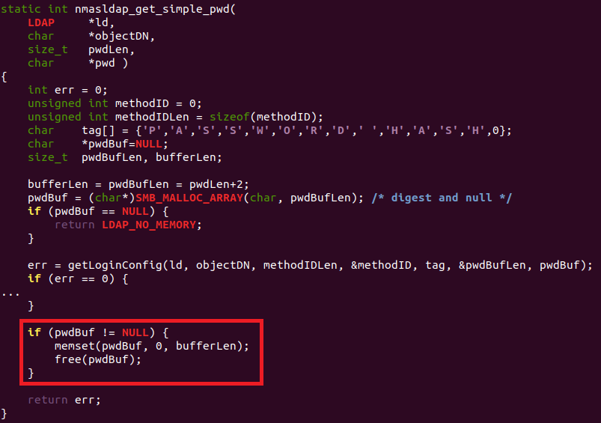
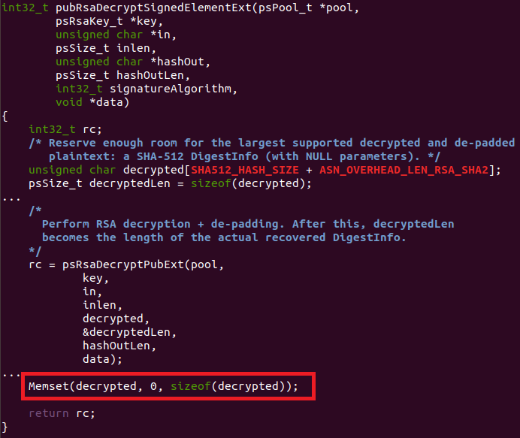
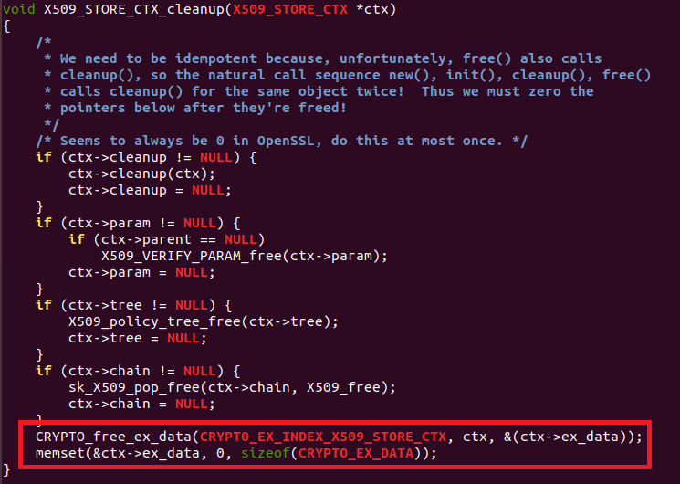
Data: Results?
OpenSSL (1.0.2q)
Mit kerb (1.16.2)
Heimdal kerb (7.4.0)
matrixSSL
Nginx (<1.15.7)
Php (7.3.0)
dhcp (4.4.1) / bind 9.11.2-P1 isc lib code
Squid-cache (4.4)
Problem is wide-spread

Slide 32
Data: Observations, realizations
The gcc patch also found some other potentially interesting bugs
memset() right after malloc() optimized out
Also for uninit stack variables in some cases
memset() right before free() optimized out
If not clearing secrets. This can still be problematic.
Other bugs close to optimized out memset()
NULL derefs
Use after free (had the memset not been optimized out)
Notes:
Bad code attracts more bad code ?

Slide 33
Variations
There’s many variations of this problem
For loop clearing byte at a time
Use of other APIs (bzero, ZeroMemory, …)
Roll your own (is compiler smart enough?)
C++ alone offers so many more possibilities
All same root cause, same problem!
Sometimes the optimizer is smart enough to see it, sometimes it’s not
If not, it might be in the future.
Notes:
Stack
Heap (does optimizer recognize malloc/free, new/delete?)

Slide 34
!c
Other languages
C# -- SecureString
Java crypto guide recommends not using string and using byte array instead
most don’t!
with things like GC you’d really want *something*
The infrastructure to deal with sensitive material is entirely missing in most programming languages
There appear to be examples where people tried to roll their own, shoehorn or otherwise bolt on a solution, with varying degrees of success.
Notes:
ONLY ONE SLIDE. SUPERFICIAL. Wish I had more time to spend on this case.
C#: problem is how to do put stuff in there in a secure manner?
Java: GC is still a problem.
In most other languages it becomes a different problem. You usually don’t have to worry about compiler optimization. You do have to worry about garbage collection, so you need the language to provide some kind of secure memory container that GC can’t mess with. Is jitting a problem ?
Free pascal compiler: - compiler experiment. Has experimental DSE optimization right now. Need to explicitly use it.
Do some testing on bouncycastle??? Write sample code to deal with secrets and write code to monitor address space for secret ….

Slide 35
Related issues
Its not uncommon to see code that doesn’t even try
E.g. no memset
Transposed memset arguments
memset(ptr, len, 0);
gcc can warn on this!
-Wmemset-transposed-args

Slide 36
Optimization related issues
Pointer overflow
if (ptr + len < ptr) bail;
Switchcase / jumptable double fetch
subtle case of not declaring expression type volatile
Optimization can make bugs more exploitable
-fdelete-null-pointer-checks
Notes:
https://www.voidsecurity.in/2018/08/from-compiler-optimization-to-code.html

Slide 37
incomplete
Fixing this isn’t the whole story
Modern compiler optimization does A LOT of clever things.
Little things, often architecture dependent.
Temporarily store stuff into registers.
Oops, turns out not enough registers. Dump reg content onto the stack.
Secrets leak out! Due to optimization. Even if you try really hard.
Simply in the course of using sensitive material correctly.
Problem echo’d in blogpost by cpercival and in notes in linux explicit_bzero manpage
Optimizing compilers and cryptography are mutually exclusive (at the present time)
Notes:
Don’t let this discourage you if you’re looking for practical advise. Look to the linux manpage which says:
Notwithstanding the above details, for security-conscious
applications, using explicit_bzero() is generally preferable to not
using it. The developers of explicit_bzero() anticipate that future
compilers will recognize calls to explicit_bzero() and take steps to
ensure that all copies of the sensitive data are erased, including
copies in registers or in "scratch" stack areas.

Slide 38
Optimization rant
Developer can reason about his code.
Can’t do the same about the generated binary if an optimization pass occurred!
Think before pulling the trigger on -O
Want optimization accountability and control!
I want a record of everything the optimizer did if I ask for it.
Should be human readable or parsable with a perl script?
Localized optimization control like MSVC offers.
Notes:
Intel seems to offer something like this ?

Slide 39
Other cute things
Memory mapped I/O
Now the OS and HW can also screw with you
Just don’t.
Interrupts / signals (w/ siglongjmp)
That is the callers problem.
Can’t fix in generic way. But caller can disable signals / interrupts.
Notes:
Others:
Mlock / wire
Hdd clearing secrets …

Slide 40
conclusions
The problem is quite obvious once you’re aware of it
One of those things that is often abstract
You want to test with your compiler settings
Look at the binary with a disassembler!
(Partial) Solutions are available, but not really portable
no complete solutions. Yet?

Slide 41
Call to action
Problem seems rampant in opensource
Go find a bug. Better yet, go fix one!
Compilers should do more to address this
Generally, want optimization accountability and control!
Standardize on something portable!
Some kind of secure memory mechanism in !c? ruby? Python? Perl? Php? Js? Go? …
Notes:
Portable AND mandatory!

Slide 42
Q&A

