Slide 1
Extended DNA Analysis
An unbiased witness or discrimination?

Slide 2
Disclaimer
Studies:
B.Sc. Biology
B.Sc. Biomedical Science/Forensic Science
M.Sc. Molecular Biotechnology
PhD Cell Biology/Cancer Research
Work:
PR Consultant for Healthcare
Science Communication

Slide 3
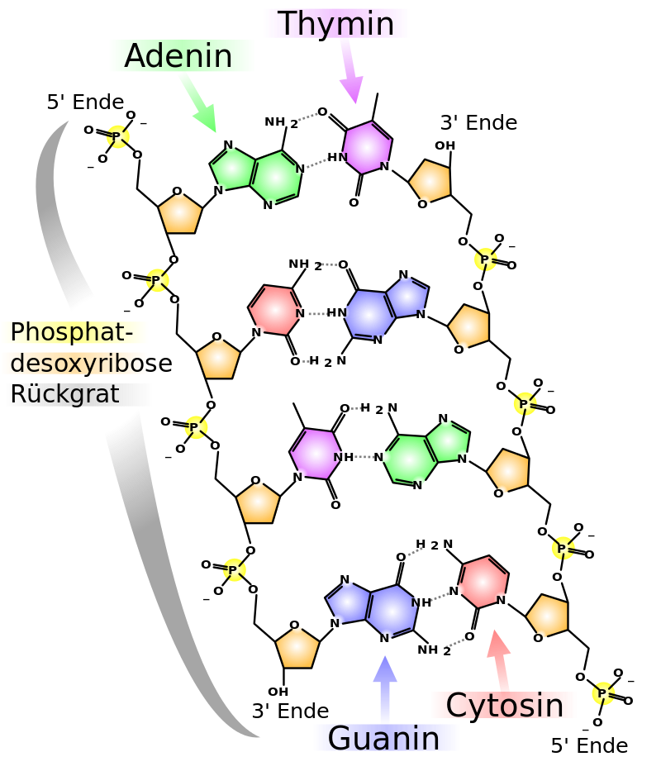
DNA
DNA stores our genetic information
DNA is made up of 4 bases
Adenine - A
Thymine - T
Guanine - G
Cytosine – C
Coding and non-coding DNA
Coding → Genes
Non-coding → Not Genes
Image: Madprime CC BY SA-3.0
Notes:
Dna carries the information how to make up our body
Its a chemical code
Phenotype: observable characteristics

Slide 4
DNA evidence
99,9 % of DNA in humans is the same
1984: Alec Jeffrey‘s discovered DNA profiling
Comparison with known profiles
Image: http://learn.genetics.utah.edu/content/science/forensics/
Notes:
3 billion bases, still a large number of differences
Identification at crimes scenes, identify relatives

Slide 5
DNA Fingerprints
Short Tandem Repeats → STR
STRs are repetitive sequences outside genes
There are many STRs with different lengths
Inherited, pattern differs from person to person
GTACTAGACTACTACTACTACTAGGTTATGG…
5 Repeats
GTACTAGACTACTACTACTACTACTAGGTTATGG…
6 Repeats
GTACTAGACTACTACTACTACTACTACTACTACTAGGT…
9 Repeats
Notes:
Among non-coding part… STRs

Slide 6
DNA Fingerprint
6
8
Gene A
Gene B
6
4
Gene A
Gene B
9
11
Gene A
Gene B
Notes:
DNA Fingerprinting uses STRs for analysis
Non-coding
These STRs do not tell uns anything about how a person looked
STRs are variable, they are different from person to person
Genes are conserved
Genes are code for protein, they affect looks, health, disease
If genes would differ much, we would all be mutants
Genes do not serve as means of identification

Slide 7
DNA Fingerprint
Separation of Amplicons by size
16 STRs analysed
DNA isolation
Amplification of STRs
Notes:
Maybe seen on TV

Slide 8
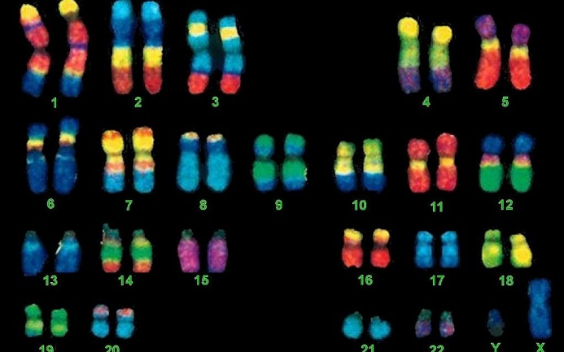
DNA Fingerprint can‘t see
Because STRs are outside of genes
Unless…
Since 2004 Sex Chromosome determination
Gene of the enamel
The gene on the X-Chromosome is 6 bases shorter
Not always accurate
Image: Memorial University of Newfoundland via JTA
Notes:
Biological sex – not gender – is determined by sex chromosomes (X and Y)
Women generally 2X, Men generally XY – different karyotypes are possible.

Slide 9
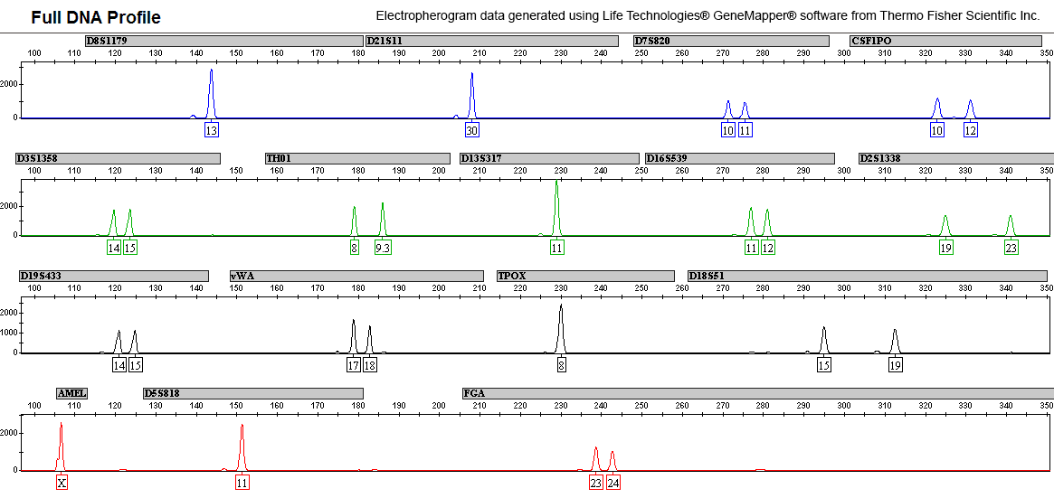
DNA Fingerprint
Means of Identification
http://www.forensicsciencesimplified.org/
Notes:
Here is what it looks like today – positive for x chromsome
You can only compare.
DNA fingerprint is useless if it does not match anyone in a database – and is not related to anyone in the database
In this case, really a fingerprint

Slide 10
Freiburg Rape case
Maria L was found raped and murdered in Freiburg, Baden-Württemberg
After a long search, one hair was found in a hedge
18,5 cm long, dyed blond
A suspect was identified via a surveillance video, which led to an arrest
17 year old afghan refugee with blond-dyed long hair and undercut
He confessed
Police said, with extended DNA Analysis, murderer would have been found sooner

Slide 11
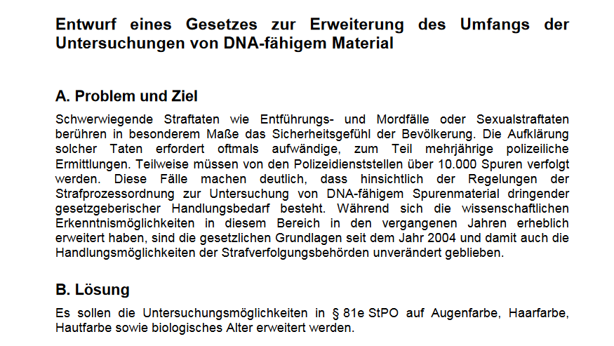
New Law: Extended DNA Analysis
§
Baden-Württemberg + Bayern Green Party and CSU
Eye color, hair color, skin color Biological age
CSU:
biogeographical ancestry
„DNA Facial composite“
Forensic DNA Phenotyping (FDP):
Analyse genes which also determine looks
http://www.bundesrat.de/bv.html?id=0117-17
Notes:
Serious crimes like abduction, murder and sexual offences
Media says „DNA Facial composite“ -> actually FDP, look on genes to find person‘s looks

Slide 12
Single Nucleotide Polymorphism
SNP
Single Base Mutations
Everywhere in the DNA
Genome Wide Association Studies (GWAS) associate SNPs with phenotypes
These do not have to be causal
GTACTAGACTAATTGCAGACATTAT
C
A
TCAACGGTCC
Notes:
Remember: DNA Fingerprints only outside genes

Slide 13
DNA „Facial Composite“
*
*
*
*
Gene A
*
Gene B
*
*
*
*
*
Gene A
Gene B
*
*
*
*
Gene A
*
Gene B

Slide 14
SNP Analysis
Next Generation Sequencing
Multiple SNP Analysis
Statistical Correlation
Soon, maybe, Whole Genome Sequencing
C
G
T
A
GATTAACGTCTGTAATA
T
GTACTAGACTAATTGCAGACATTATATCAACGGTCC

Slide 15
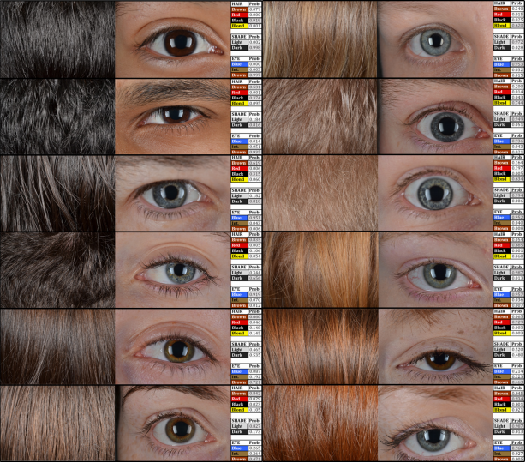
Accuracy
Biogeographic Ancestry
Continental: Up to 99%
Hair Color
About 70 - 90 %
Eye Color
Blue or Brown >90 %, other ~70 %
Skin Color
~80 – ~90 %
Kayser, 2015
Notes:
Probability of correct result
Always depends on population
Pigmentation is connected to BGA -> but just information on ancestors, not where person comes from

Slide 16
Kayser, 2015
Notes:
Redhead: 50/50! Dangerous to draw assumptions here

Slide 17
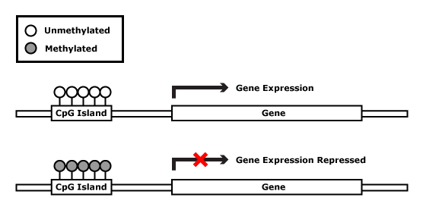
Biological Age
DNA methylation pattern
Age specific-CpG islands
Repetition of bases C and G before a gene
Regulates Gene Expression

Slide 18
Biological Age
Gene A
Gene B
Gene A
Gene B
Gene A
Gene B

Slide 19
DNA Methylation Analysis
Chemical treatment leads to base change in unmethylated DNA
methylated
GTACTAACTAATTGCAGACATTATTCGCAACGGTCC
CH₃
unmethylated
GTACTAACTAATTGCAGACATTATTCGCAACGGTCC
U

Slide 20
Accuracy
Healthy samples:
Mean error: 3-5 years
Some up to 20 years
Diseases such as cancer and anemia can confound the results
Mixed tissues can also pose a problem
Notes:
Makes sense to live extremely healthy to outsmart this system… or unhealthy

Slide 21
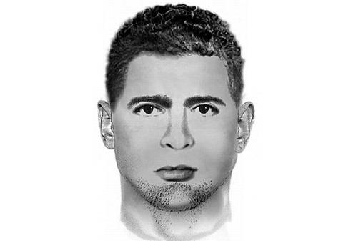
DNA Facial Composite
What‘s advertised:
Reality:
Approximation
37 ± 4 years
23 ± 4 years
Maybe
Image: Polizeidirektion Dresden
Notes:
IMPORTANT: Look around you who fits either od these profiles

Slide 22
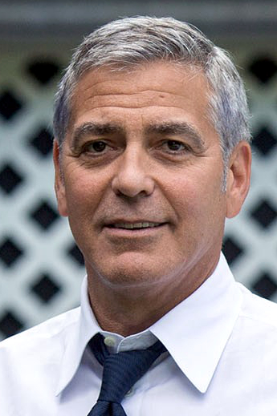
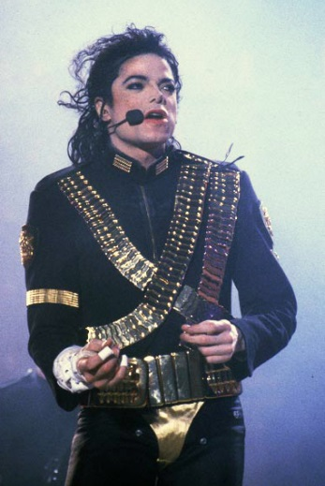
DNA does not equal phenotype
Tim Travers Hawkins (CC BY-SA 4.0)
Notes:
Goerge Clooney used to be black-haired
Micheal Jackson was black as a child
People born with XY-Chromosomes are sometimes female

Slide 23
Other Factors
Notes:
Blond children can become brown haired adults
Hair is most easily colored

Slide 24
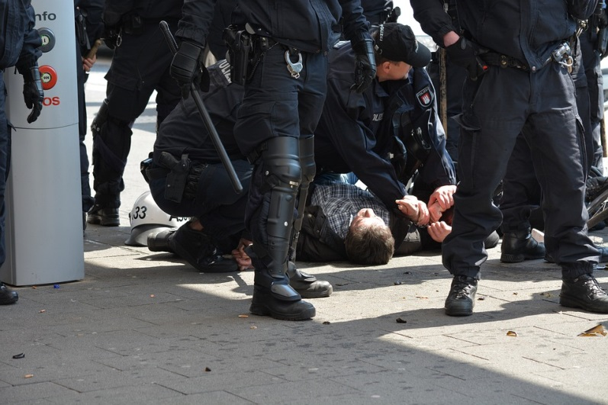
Problems with FDP
Suspicion Reversal
Police has to prove your guilt
With Extended DNA Analysis you will be a
Non-suspect person of interest
Presumption of innocence?
“Suspicion-less seizure of persons and then demanding proof of that person’s innocence inverts our structural arrangement of power between law enforcement and the individual”
Toom, 2015
Notes:
Paper on Ethics by Toom et al, social scientist from Frankfurt

Slide 25
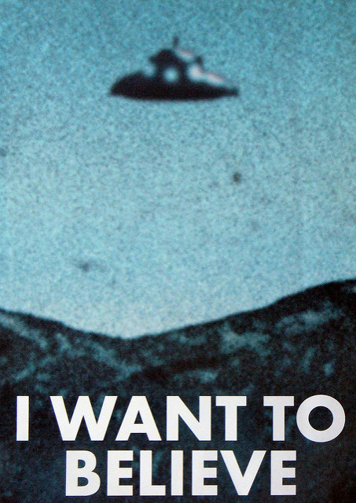
Is DNA Unbiased?
Science = Facts
FDP „unbiased witness“, infallible and factual
However: Extended DNA Analysis only gives an estimation
DNA evidence has to be interpreted and is prone to bias
http://www.forensic-pathways.com/confirmation-bias-ethics-and-mistakes-in-forensics/
Scott Vandehey, CC BY-NC-SA 2.0
Notes:
Why biased: If we think we know something, we do not like to be wrong
Expectancy effect: An example would be expecting an identification because the officer stated that the suspect was caught on tape and the officer just needs to have the print identified. This could also be seen when working crime scenes. If the initial contact at the scene tells the investigating officer that it is a suicide, then the investigating officer might anticipate finding a suicide. However, we cannot allow our expectations to form our conclusions.
Selective Attention: Prior expectations, along with selective attention, can push us into that “zone” by priming our mind to look for information that will confirm our preexisting beliefs and disregard all other information. This cognitive bias is stronger than one might believe. It can overpower the correct conclusion in an ambiguous case; however, it will not affect the conclusion in an unambiguous case.
When a person gathers information over a period of time and then comes to a conclusion, it is the information that is gathered earlier in the process (rather that later) that is likely to carry more weight in the decisionmaking.

Slide 26
Confirmation Bias
Bias to think about positive rather than negative information
Expectancy effect: Anticipation of outcome
Selecttive Attention: attention to items of interest and disregard contradictory information
Positivity bias: We tend to affirm the things that we want to be true.
Primacy effect: Earlier information is perceived as „more true“
Therefore, DNA is not an „unbiased witness“
Scott Vandehey, CC BY-NC-SA 2.0
http://www.forensic-pathways.com/confirmation-bias-ethics-and-mistakes-in-forensics/
Notes:
Why biased: If we think we know something, we do not like to be wrong
Expectancy effect: An example would be expecting an identification because the officer stated that the suspect was caught on tape and the officer just needs to have the print identified. This could also be seen when working crime scenes. If the initial contact at the scene tells the investigating officer that it is a suicide, then the investigating officer might anticipate finding a suicide. However, we cannot allow our expectations to form our conclusions.
Selective Attention: Prior expectations, along with selective attention, can push us into that “zone” by priming our mind to look for information that will confirm our preexisting beliefs and disregard all other information. This cognitive bias is stronger than one might believe. It can overpower the correct conclusion in an ambiguous case; however, it will not affect the conclusion in an unambiguous case.
When a person gathers information over a period of time and then comes to a conclusion, it is the information that is gathered earlier in the process (rather that later) that is likely to carry more weight in the decisionmaking.

Slide 27
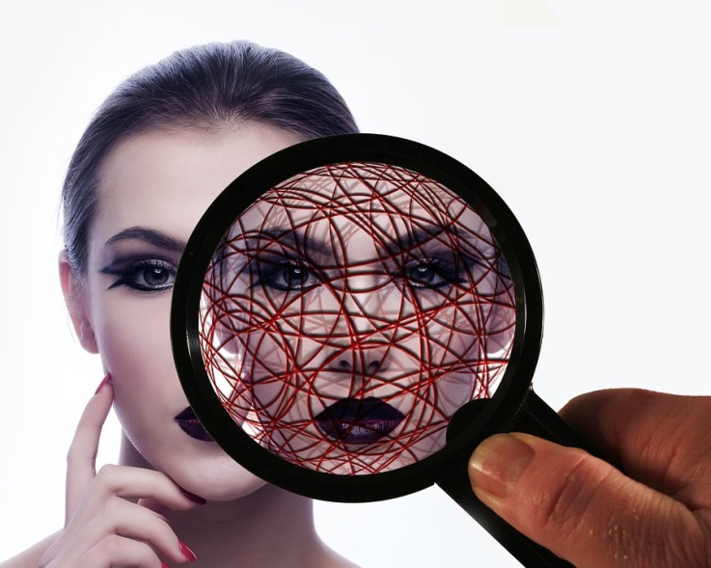
Privacy
Law‘s Hypothesis: Openly visible features determined from DNA are not private
Appearance != Statistical correlation
Context
Genes on looks and biogeographic background always tell us more than we ask
Skin color:
Risk of skin cancer
Heart disease
Age is a risk factor for many diseases
Notes:
2 major issues on privacy:
decontextualized statistical information about a person’s most likely appearance,
eye witness accounts often provide important context about the events of a crime.

Slide 28
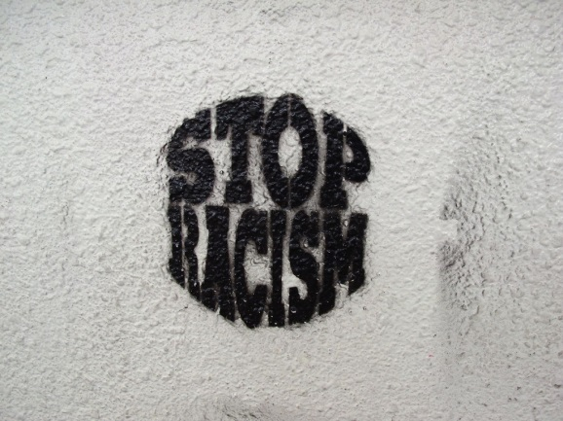
Discrimination
By definition, FDP discriminates people with different ethnicities
Relevant suspect groups will always be minorities
Predominant population is too large
Openly discussed FDPs of DNA traces can lead or add to hate crimes
If deployed, FDP needs to be confidential, to avoid stigmatization of whole subpopulations
Image: Li Tsin Soon CC-BY-NC-ND 2.0

Slide 29
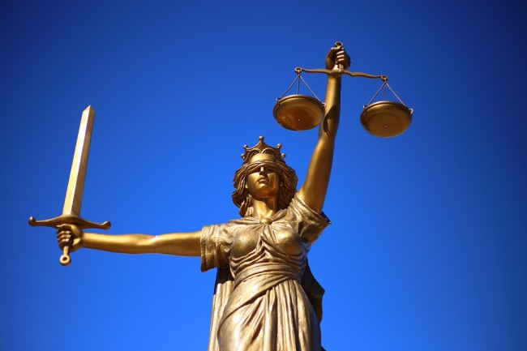
Emotional Debate
The law for FDP was proposed after a very brutal rape case
FDP was demanded by right extremism groups
However:
The new law would not have helped the investigation
Perpetrator had strikingly dyed hair which was the reason he could be identified in a surveillance video
Notes:
Laws help us to act rational under emotional circumstances

Slide 30
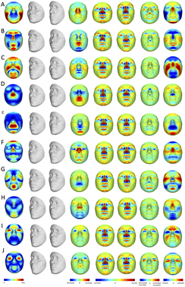
Outlook
Body height
Body stature
Hair loss
Hair structure
Face structure
Image: Claes, 2015
Notes:
Here you see approximations of facial structures by SNP analysis

Slide 31
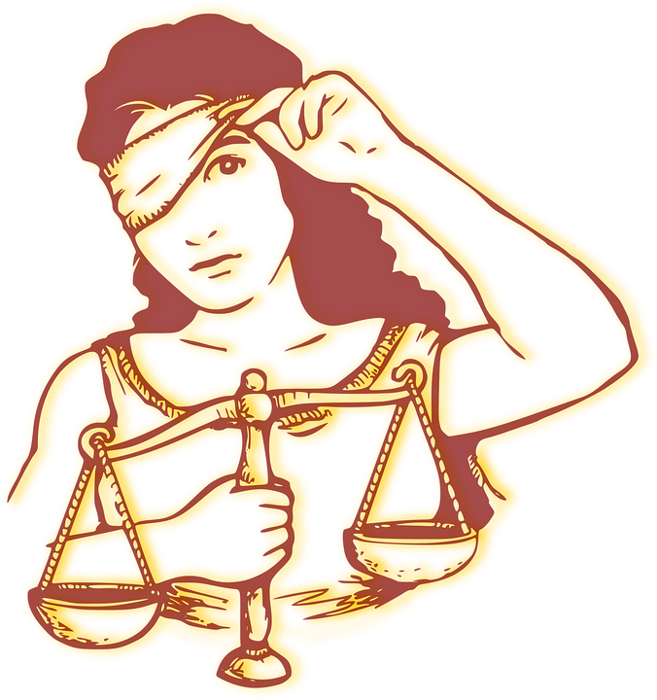
Extended DNA Analysis
Uses Genome Wide Association Studies (GWAS) to approximate
Looks
Age
Biogeographical ancestry
Maybe much more
It is not a means of identification but approximation
By definition
It is discriminatory
It targets minorities
It is biased and therefore can lead into the wrong direction

Slide 32
What to do?
If FDP is to come
Only as a method of last resort, when everything else has failed
Confidential
Precautions to avoid confirmation bias
No one and nothing is infallible
No one is unbiased
Every wrongful investigation of a suspect leaves the real perpetrator unprosecuted

Slide 33
The new Law:
Conference of ministers of internal affairs (Innenminsterkonferenz)
Part of the „Security Package“
Herbert Reul:
„Nobody understands, why forenic scientists can form very precise facial composites from very small traces, but our police cannot use them.
Well, now you understand…
Notes:
Security Package also targets Toll charge data anaylsis and the surveillance of instant messaging such as Whatsapp as „Terror prevention“
WIRKEN LASSEN!!!!!

Slide 34
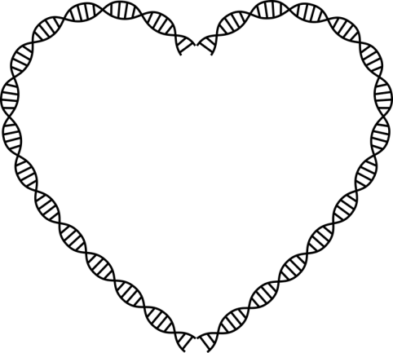
Thank you for your attention
Zellmedien.com // @_adora_belle_
STS@Freiburg Prof. Veronika und Prof. Anna Lipphardt: https://stsfreiburg.wordpress.com/

