Slide 1
Hackerspace Design Patterns 2.0
Mitch Altman
Chief Scientist, Cornfield Electronics, San Francisco, CA
Inventor of TV-B-Gone universal remote controls
Author of The Brain Machine in MAKE Magazine #10
Co-founder of Noisebridge (San Francisco hacker space)
email: mitch@CornfieldElectronics.com
site: www.CornfieldElectronics.com
twitter: @maltman23
flickr: maltman23
phone: +1 415-377-5993
+49 152 2723 0510
DECT: 2676 (CORN)

Slide 2
Our Community

Slide 3
Hackerspace
Design Patterns 1.0

Slide 4
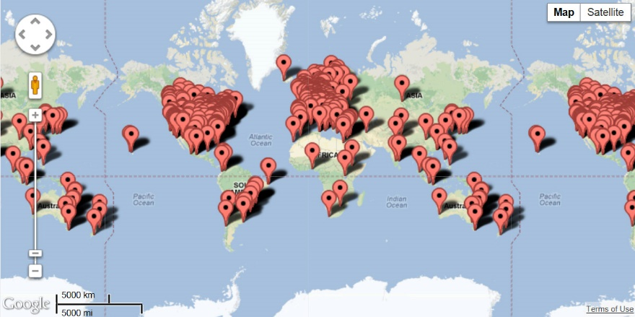
2,000 + Hackerspaces
and Growing…
hackerspaces.org

Slide 5
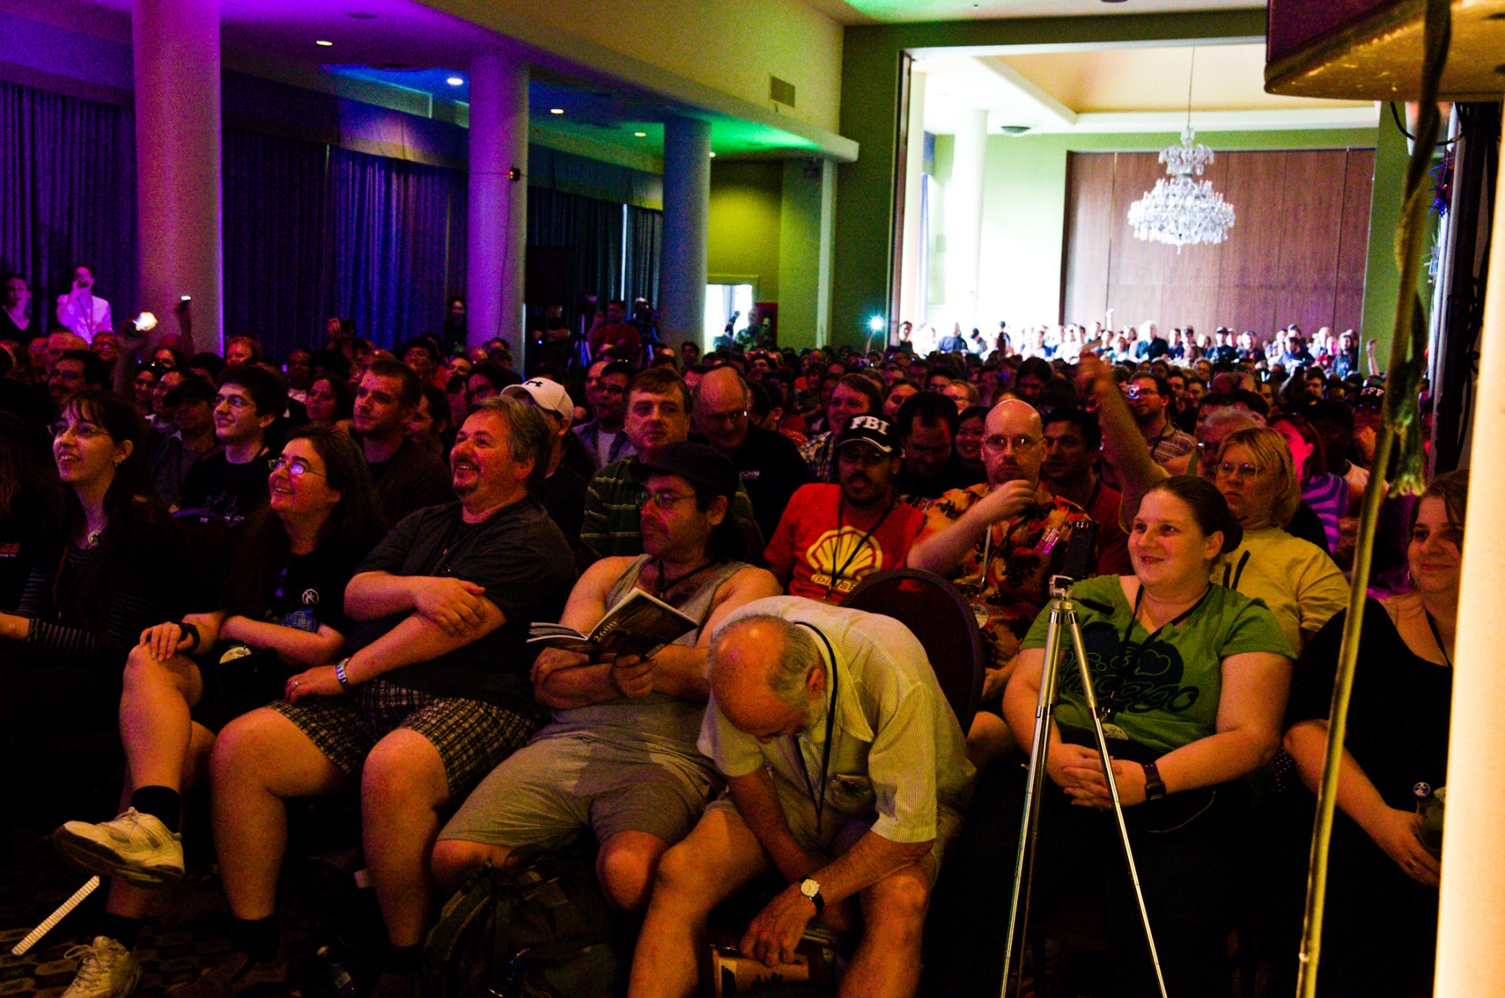
My first hacker conference

Slide 6
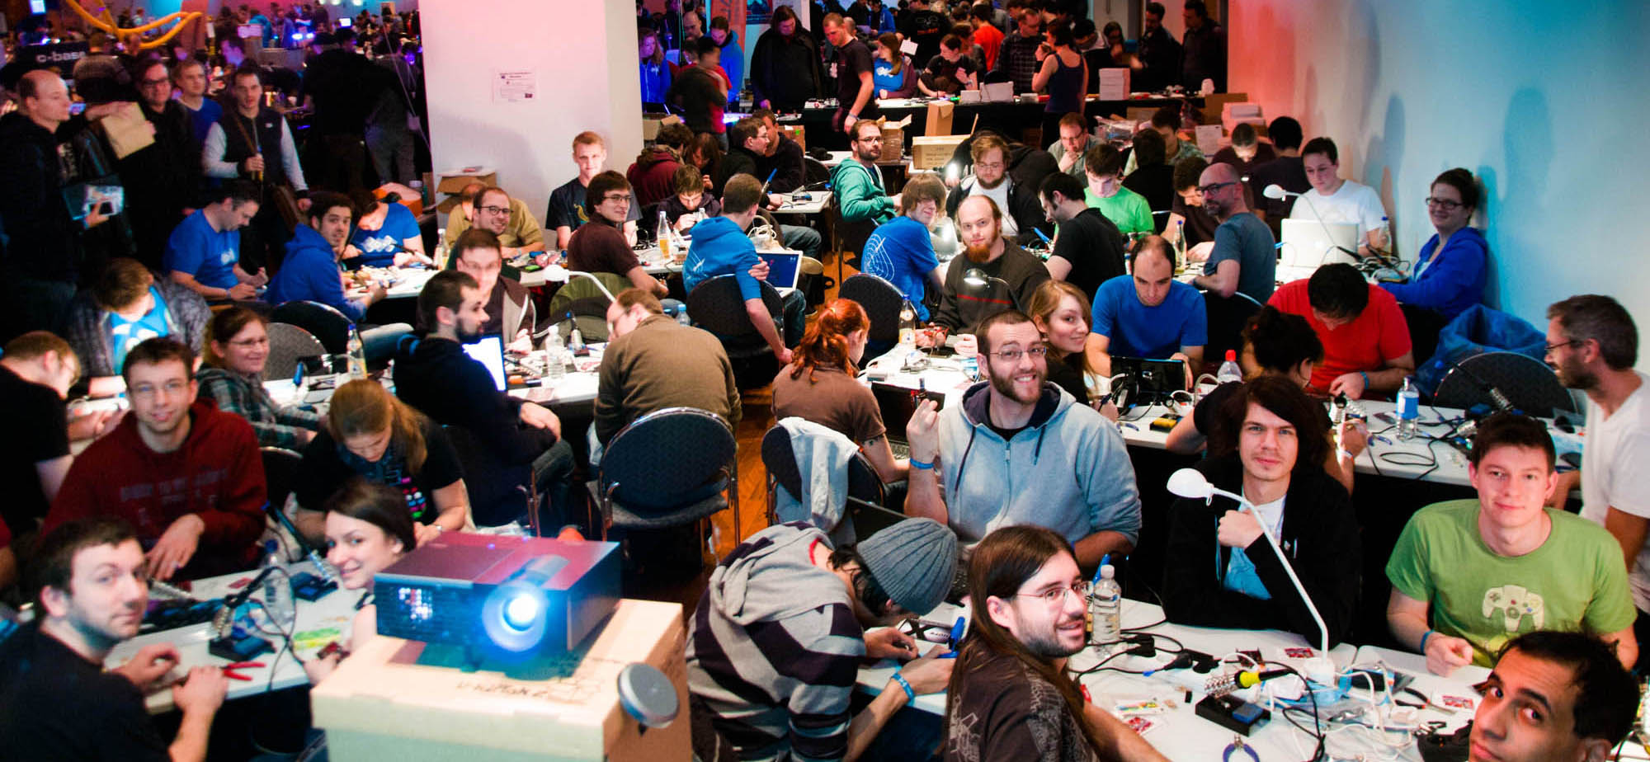
Community

Slide 11
Not a Cookbook
“Your Mileage May Vary”

Slide 13
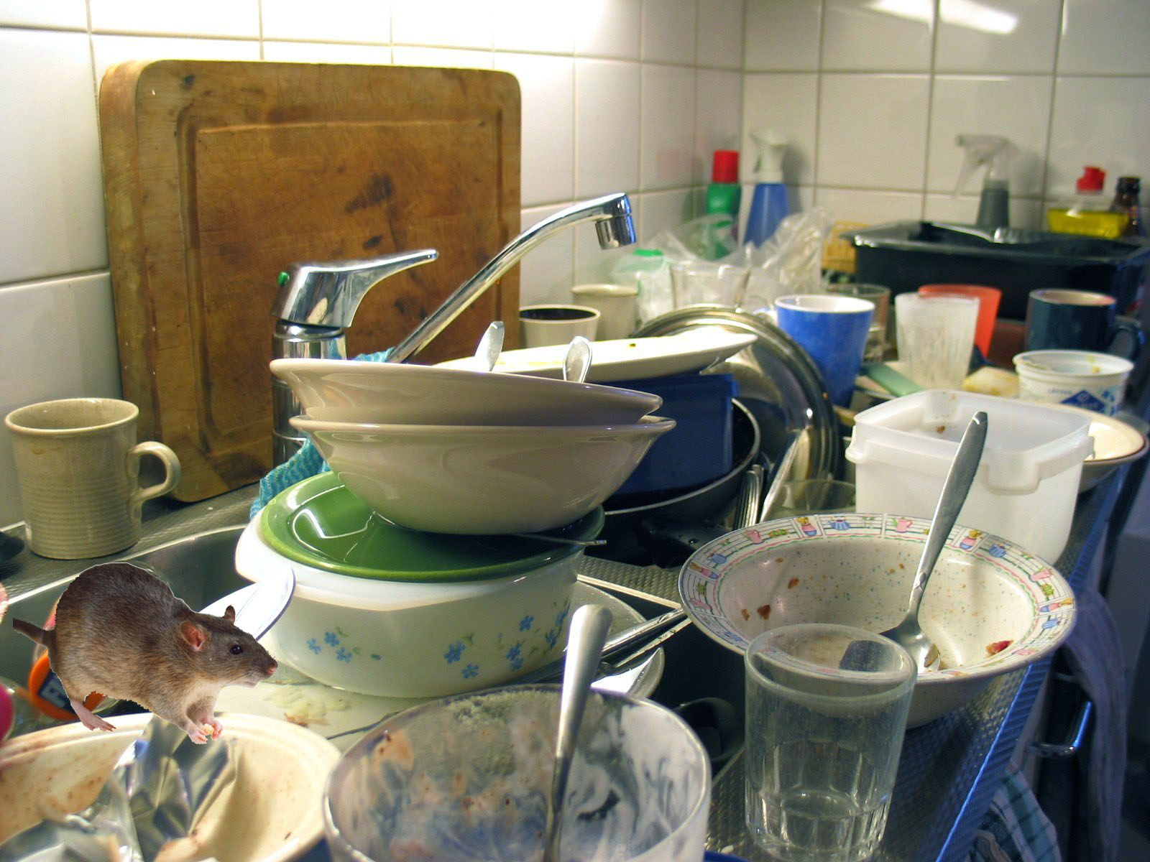
The Kitchen Anti-Pattern

Slide 14
More!

Slide 15
The Mentor Pattern
Problem
On-boarding new members is difficult. New members can have trouble finding the resources they need and learning their responsibilities as members.
Implementation
Every new member is assigned an experienced member as a mentor. When the member has a question, they can go to the mentor to find the answer. If the member is acting out of line with the group's principles, the mentor can talk to them.

Slide 16
The Cultural Immune System Pattern
Problem
You want people in your hackerspace who are good for your community, and want to keep them happy and safe -- and you don't want to attract people who will hurt your community or drive away people who are good for your community.
Implementation
"Cultural immune system". Get the entire community involved with attracting new people who belong. Greet new people at the door, give them a tour, including what your community is and is not about. Keep people who don’t belong out of the space. Define what it means to belong and not belong.

Slide 17
The Reboot Pattern
Problem
At the beginning, all are involved in creation of the space. The newness fades over time. Troubles/problems ensue.
Implementation
Reboot the space!
Close the space. Kick everyone out. Only let in people to fix the space. Throw a party.
Continue to only let in people good for the community.

Slide 18
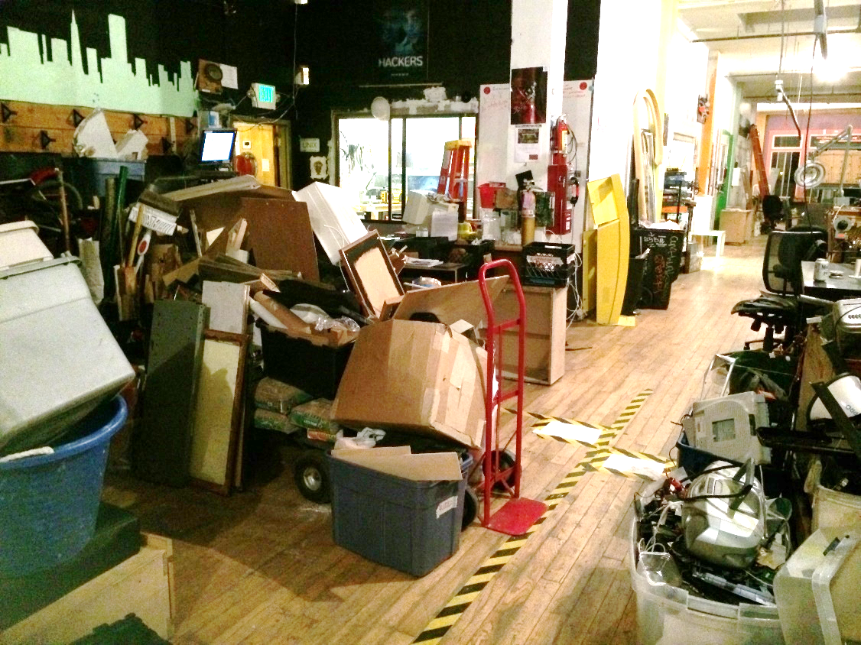
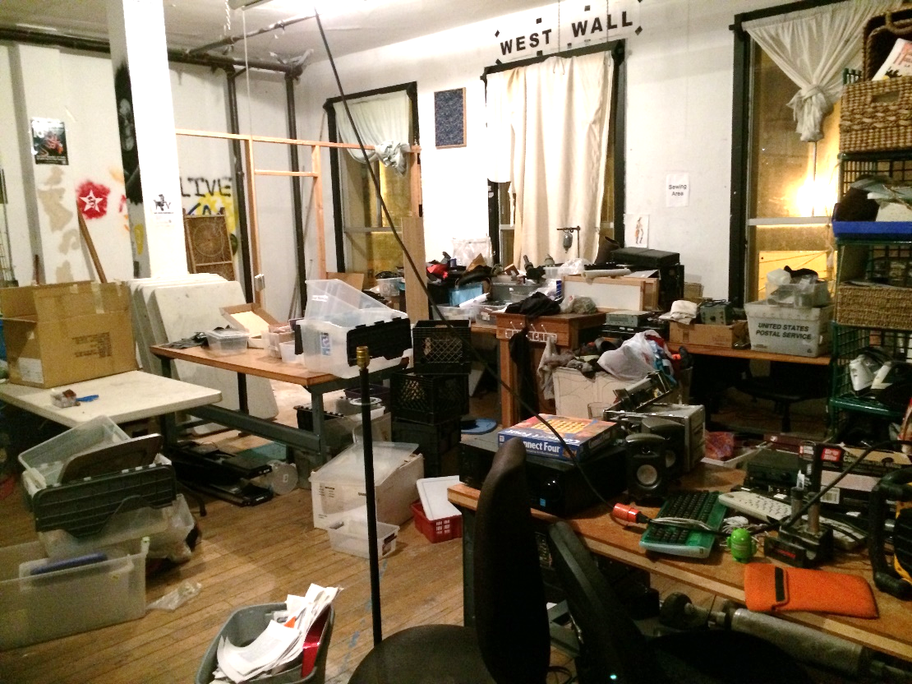
Noisbridge: Reboot!
Before
Notes:
Yet, all studies ever done on education show that the ability to take tests has little to no correlation with how well the test-taker will do at anything. Not how well they will do in school, or how well they will do at a job. Or, at life. The only thing it correlates with is: how well they will do at taking tests.
Is this education? Yes!
Is this good education? No!
Can education actually prepare students for living the lives they want to live? Yes!
And this is why we are here today. To explore ways for bringing real education to students.
One powerful (and inexpensive) pedagogical methodology is: hackerspaces, and the hacker spirit that it engenders.

Slide 19
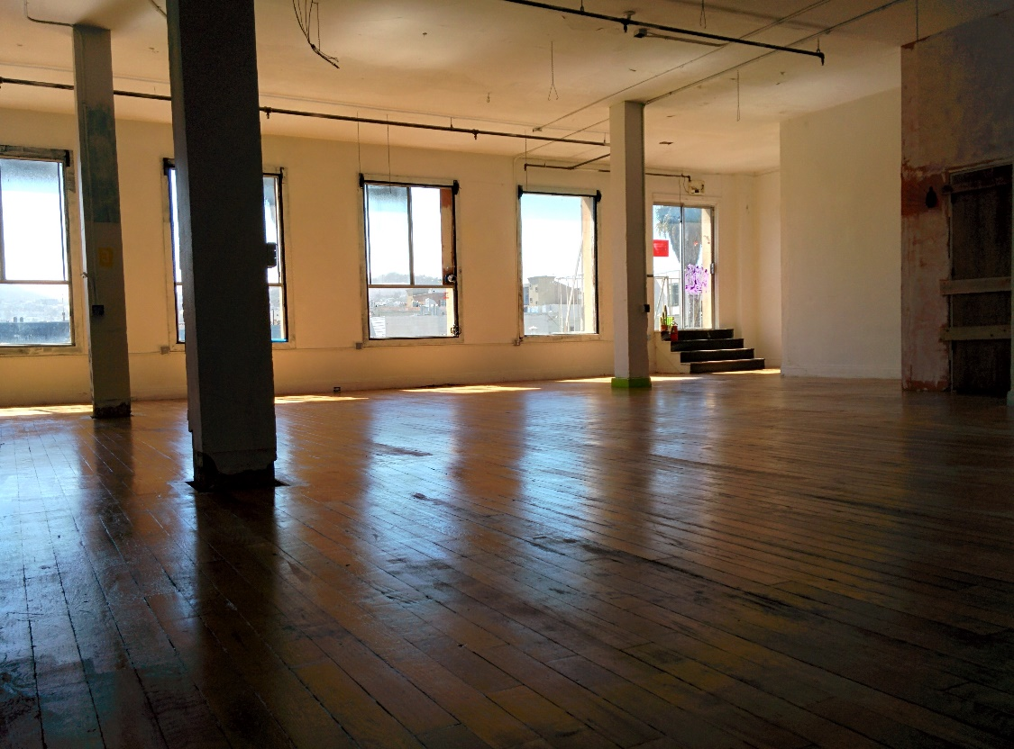
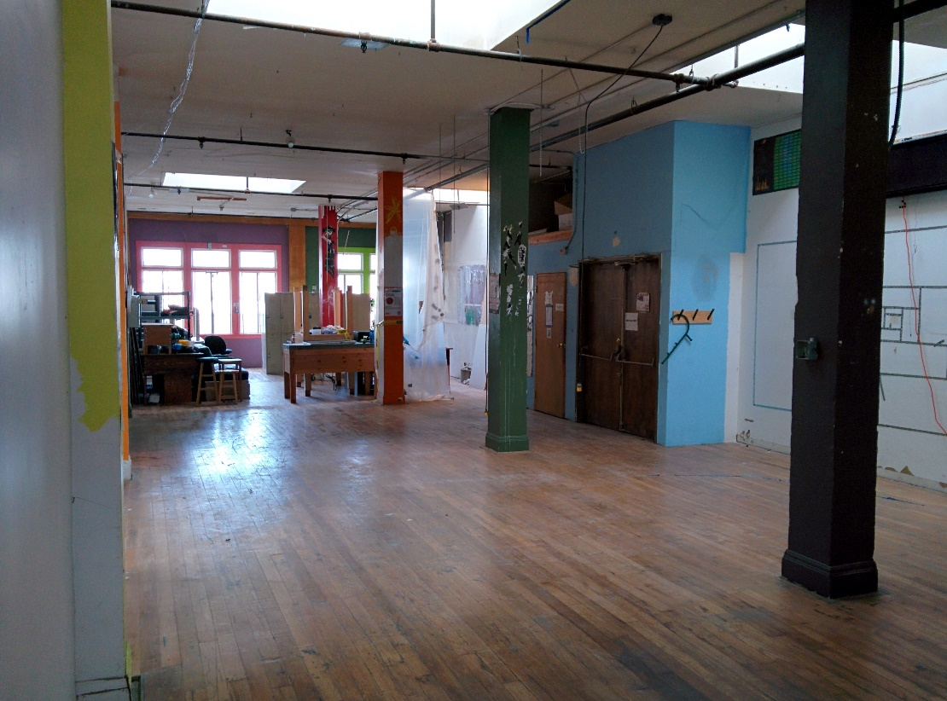
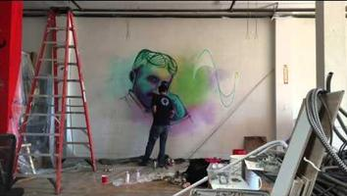
Noisbridge: Reboot!
During
Notes:
Yet, all studies ever done on education show that the ability to take tests has little to no correlation with how well the test-taker will do at anything. Not how well they will do in school, or how well they will do at a job. Or, at life. The only thing it correlates with is: how well they will do at taking tests.
Is this education? Yes!
Is this good education? No!
Can education actually prepare students for living the lives they want to live? Yes!
And this is why we are here today. To explore ways for bringing real education to students.
One powerful (and inexpensive) pedagogical methodology is: hackerspaces, and the hacker spirit that it engenders.

Slide 20
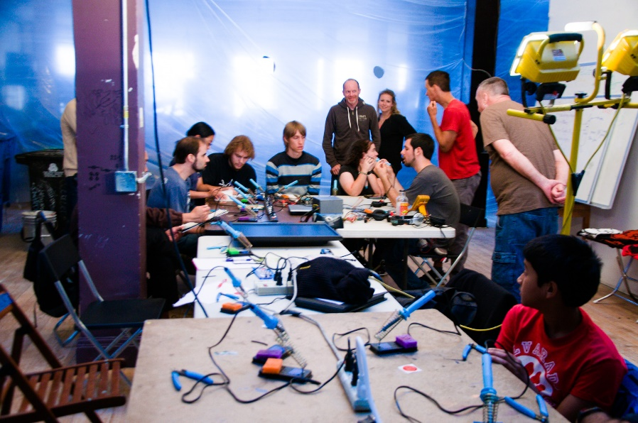
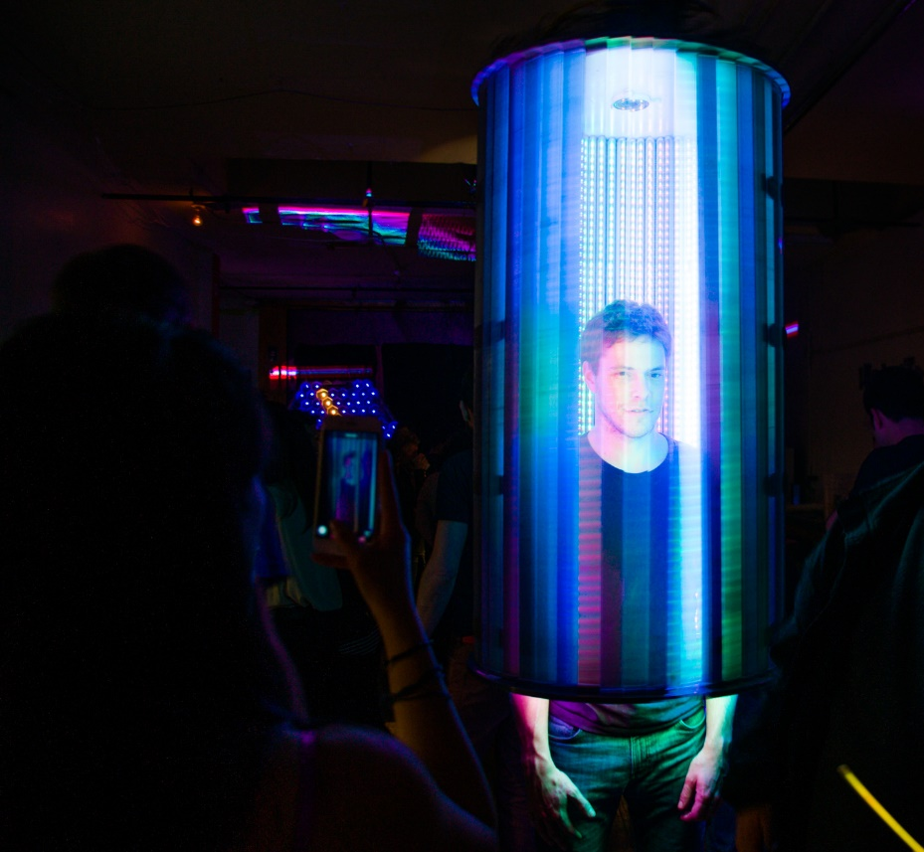
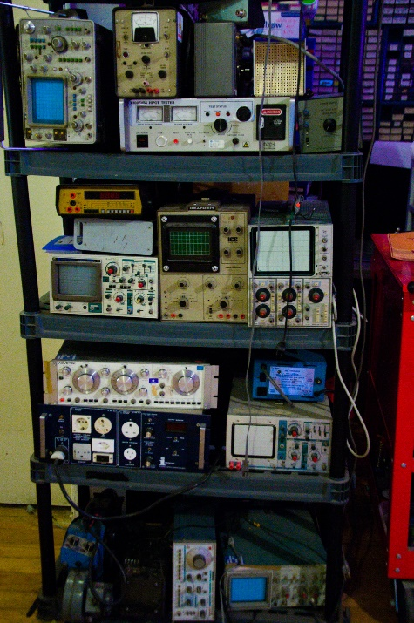
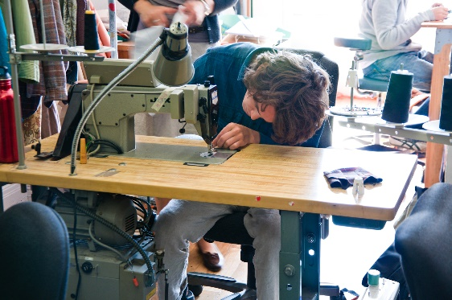
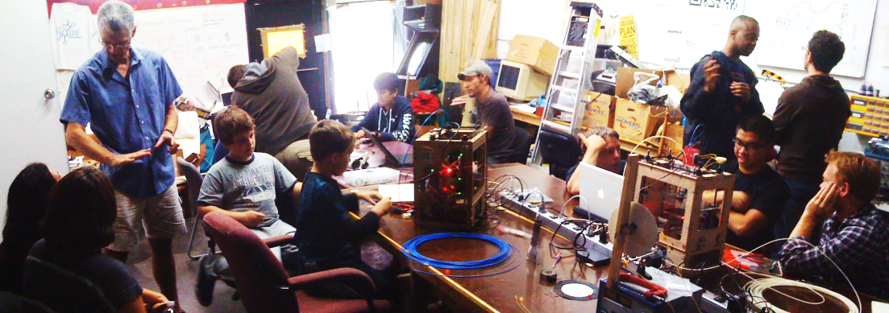
Noisbridge: Reboot!
After
Notes:
Yet, all studies ever done on education show that the ability to take tests has little to no correlation with how well the test-taker will do at anything. Not how well they will do in school, or how well they will do at a job. Or, at life. The only thing it correlates with is: how well they will do at taking tests.
Is this education? Yes!
Is this good education? No!
Can education actually prepare students for living the lives they want to live? Yes!
And this is why we are here today. To explore ways for bringing real education to students.
One powerful (and inexpensive) pedagogical methodology is: hackerspaces, and the hacker spirit that it engenders.

Slide 21
More!

Slide 22
An Invitation

Slide 23
Another Invitation

Slide 24
Hackerspace Design Patterns 2.0
Mitch Altman
Chief Scientist, Cornfield Electronics, San Francisco, CA
Inventor of TV-B-Gone universal remote controls
Author of The Brain Machine in MAKE Magazine #10
Co-founder of Noisebridge (San Francisco hacker space)
email: mitch@CornfieldElectronics.com
site: www.CornfieldElectronics.com
twitter: @maltman23
flickr: maltman23
phone: +1 415-377-5993
+49 152 2723 0510
DECT: 2676 (CORN)

