Slide 2
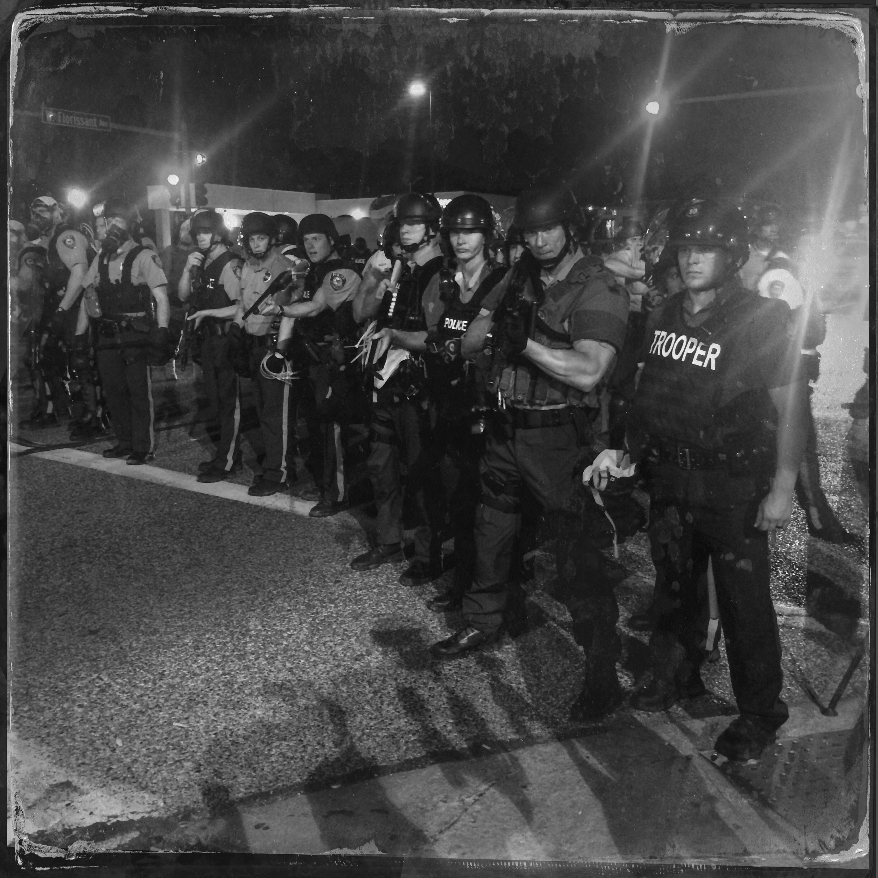

Slide 8
DHS Grant Programs
State Homeland Security Program: $ 9.9 billion (2003-2014)
Urban Areas Security Initiative: $ 8.4 billion (2003-2014)
Port Security Grant Program: $ 2.9 billion (2002-2014)

Slide 10
DHS Grants

