Slide 1
Making coils more musical
josh@vandervecken.com

Slide 2
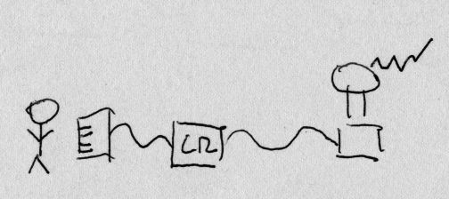
Overview
CHIME RED is a MIDI controlled synthesizer that enables a musician to control a Tesla coil

Slide 3
Demonstration: power
https://www.youtube.com/watch?v=oAEIUm6YG4M
Dynamic power scheduling per pulse

Slide 4
Demonstration
https://vimeo.com/123003833 (4:30)
3 coils, robot drummer, robot bass player
Original composition by Jason Long, bass player by James McVay and Jim Murphy

Slide 5
Presentation summary
What do I mean by “music” :-)
Demonstration videos
How Tesla coils make sound (rapid heating of air, interaction with environment)
What control the musician has (via MIDI)
Future developments

Slide 6
Side note
I am not a musician (some of my best friends are)
I am still learning to be an instrument maker
Would love to learn from you if you have ideas or suggestions!

Slide 7
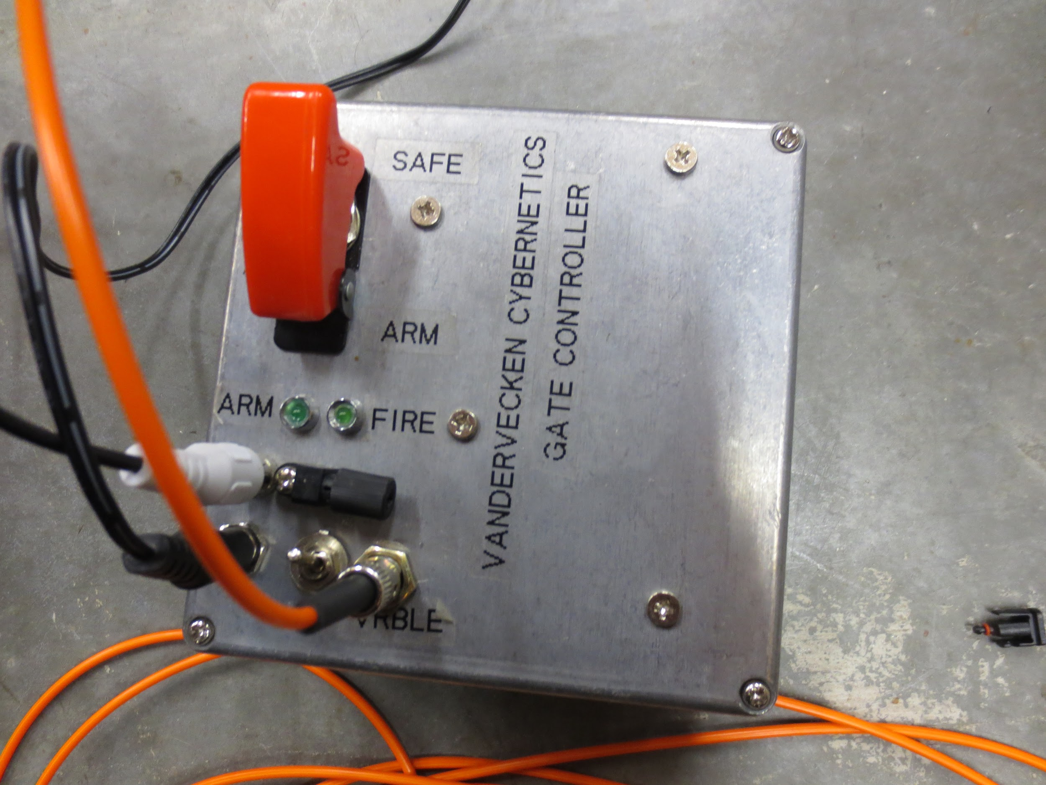
My idea of a user interface

Slide 8
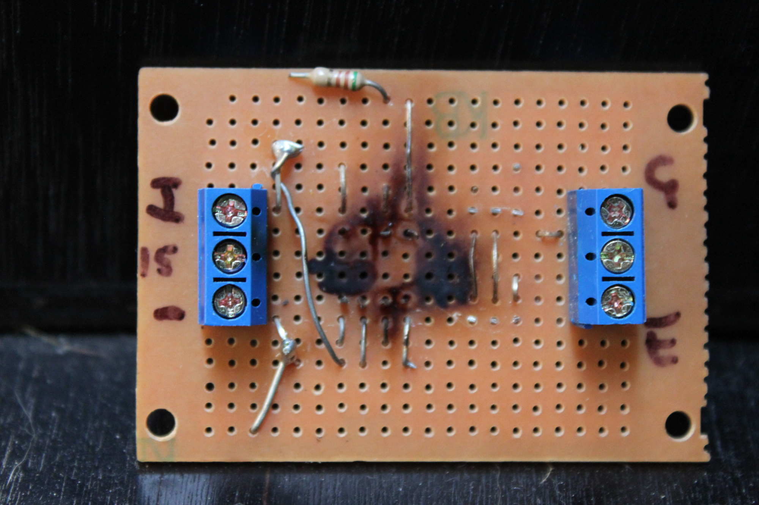
Not a hardware expert

Slide 9
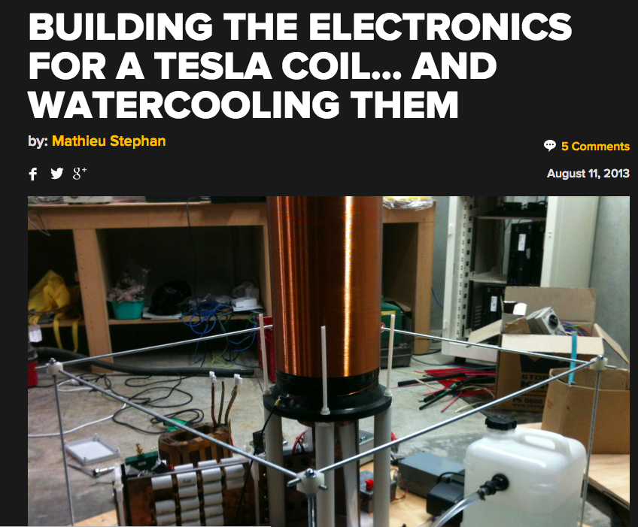
Patrick is an expert

Slide 10
Tesla coil sound
Rapid (explosive) heating of air
Interaction with/evaporation of environment

Slide 11
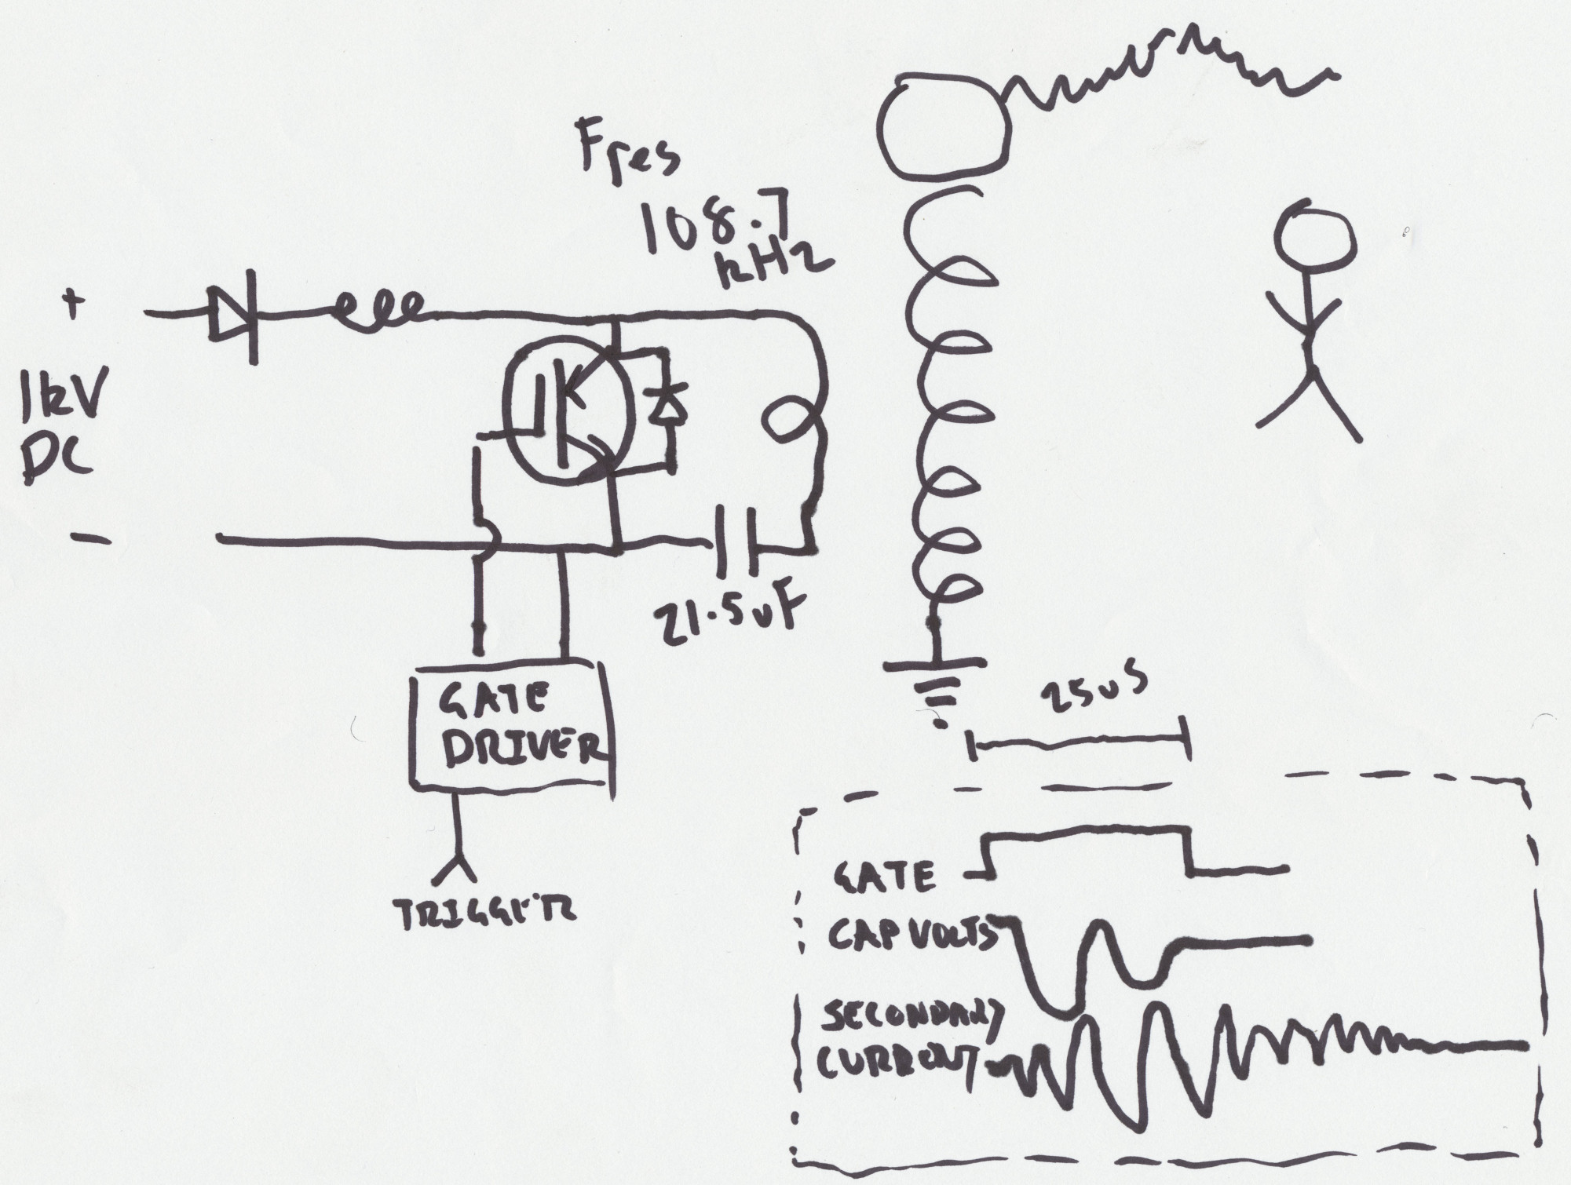
Tesla coil schematic

Slide 12
Controlling power
Choosing when to heat the air
Doing that many times per second (Eg 261Hz is about middle C)
But also be careful when playing multiple notes and effects and how much power (otherwise - BANG)

Slide 13
Controlling power precisely
Tesla coils use very high current pulses
Too large pulses, too often will destroy the coil (and your ears)
Key is to control how large the pulses are and when to send them relative to other pulses
CHIME RED :-)

Slide 14
Musicians and high voltage
Musicians want to make music
Tesla coils are dangerous
MIDI is a way to separate the two
CHIME RED makes a Tesla coil “look” like a conventional synthesiser, so that Ableton, MIDI keyboards, etc can control it

Slide 15
What is MIDI?
Musical Instrument Digital Interface (circa 1983)
Connecting controllers (Eg keyboards and computers) and noise making things (Eg synthesisers)
Very simple protocol - start/stop notes
Originally just a serial port at 33kbps, no acknowledgement of messages (see panic - later)
Traditionally a 5-pin DIN cable

Slide 16
Musical requirements
Many notes at once (chords)
Dynamics (controlling the “volume” of each note)
Pitch changes (changing the pitch as a note plays)
Combining many waveforms together

Slide 17
Common limits
One, or maybe two notes at once (no or very simple chords only)
No control of dynamics (no way to control volume)
One oscillator per note (very simple tone)

Slide 18
Development
2012
PIPE ORGAN (4 notes, no dynamics)
NEMO (4 notes, dynamics - Blake Johnson)
2013
PIPE ORGAN (add primitive dynamics, experiment)
2014
CHIME RED

Slide 19
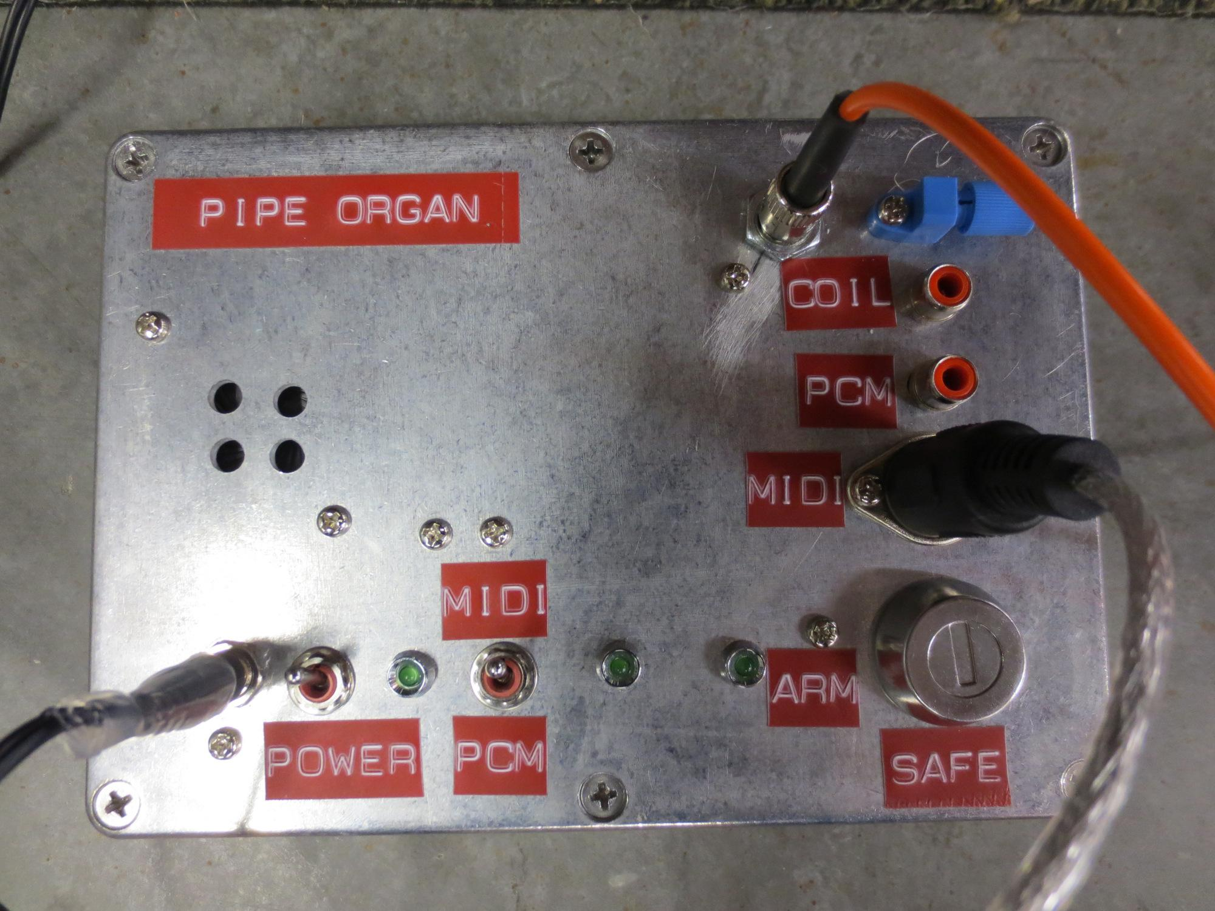
PIPE ORGAN prototype

Slide 20
CHIME RED specifications
16 notes at once
Multiple oscillators per note
Control of dynamics (volume)
LFOs (combining waveforms)
FM synthesis

Slide 21
Multiple oscillators per note: demo
https://www.youtube.com/watch?v=pzE-7ditJwo

Slide 22
AM LFO: demo
https://www.youtube.com/watch?v=utWfqhs2ZWc

Slide 23
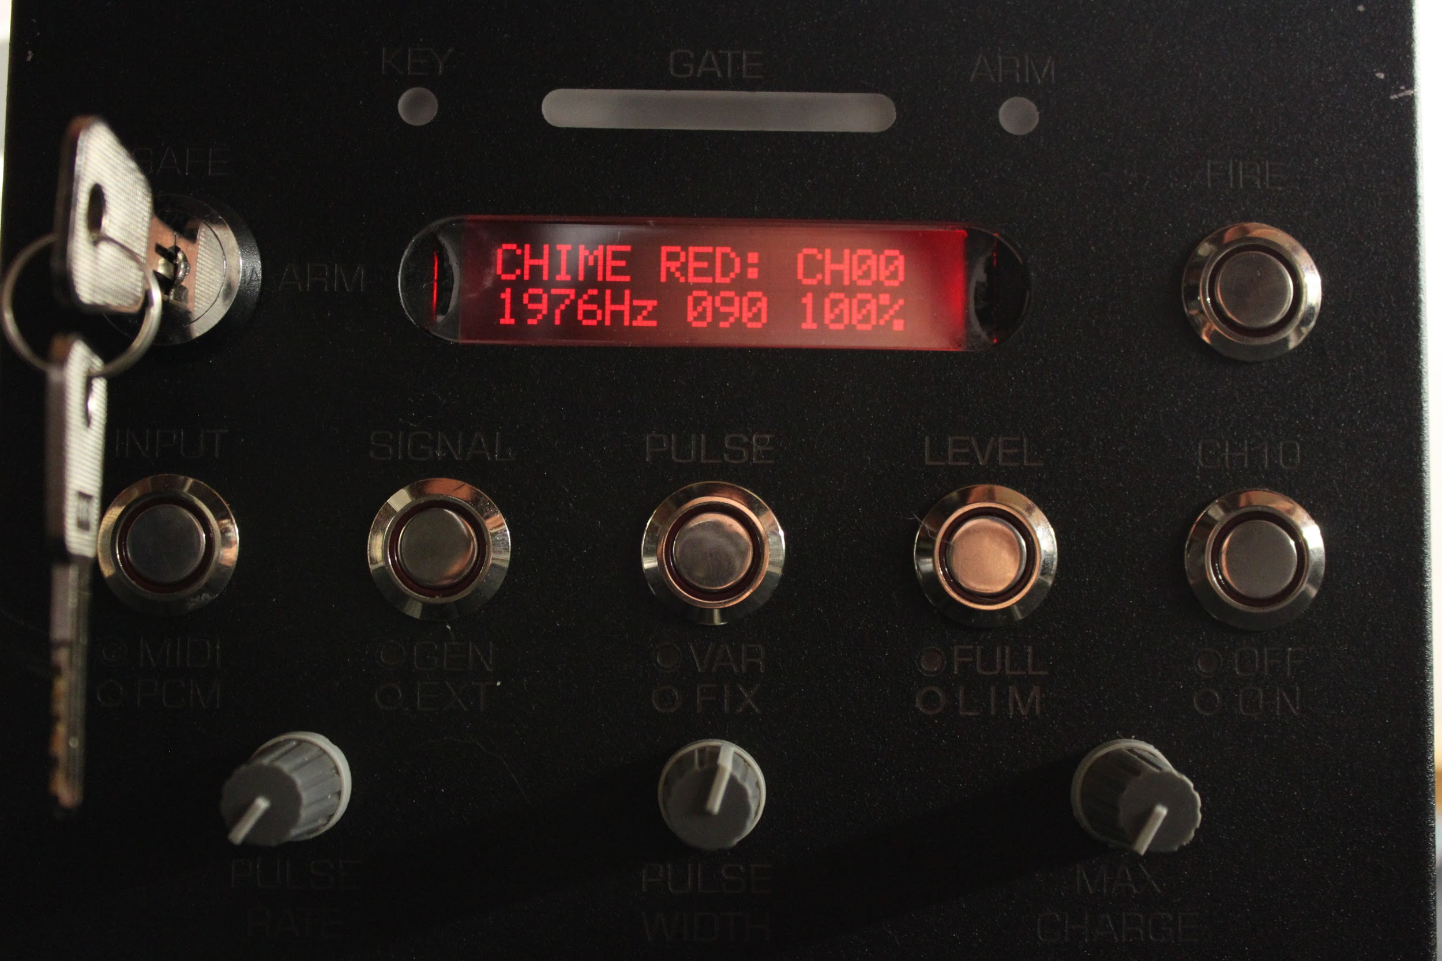
CHIME RED: front panel

Slide 24
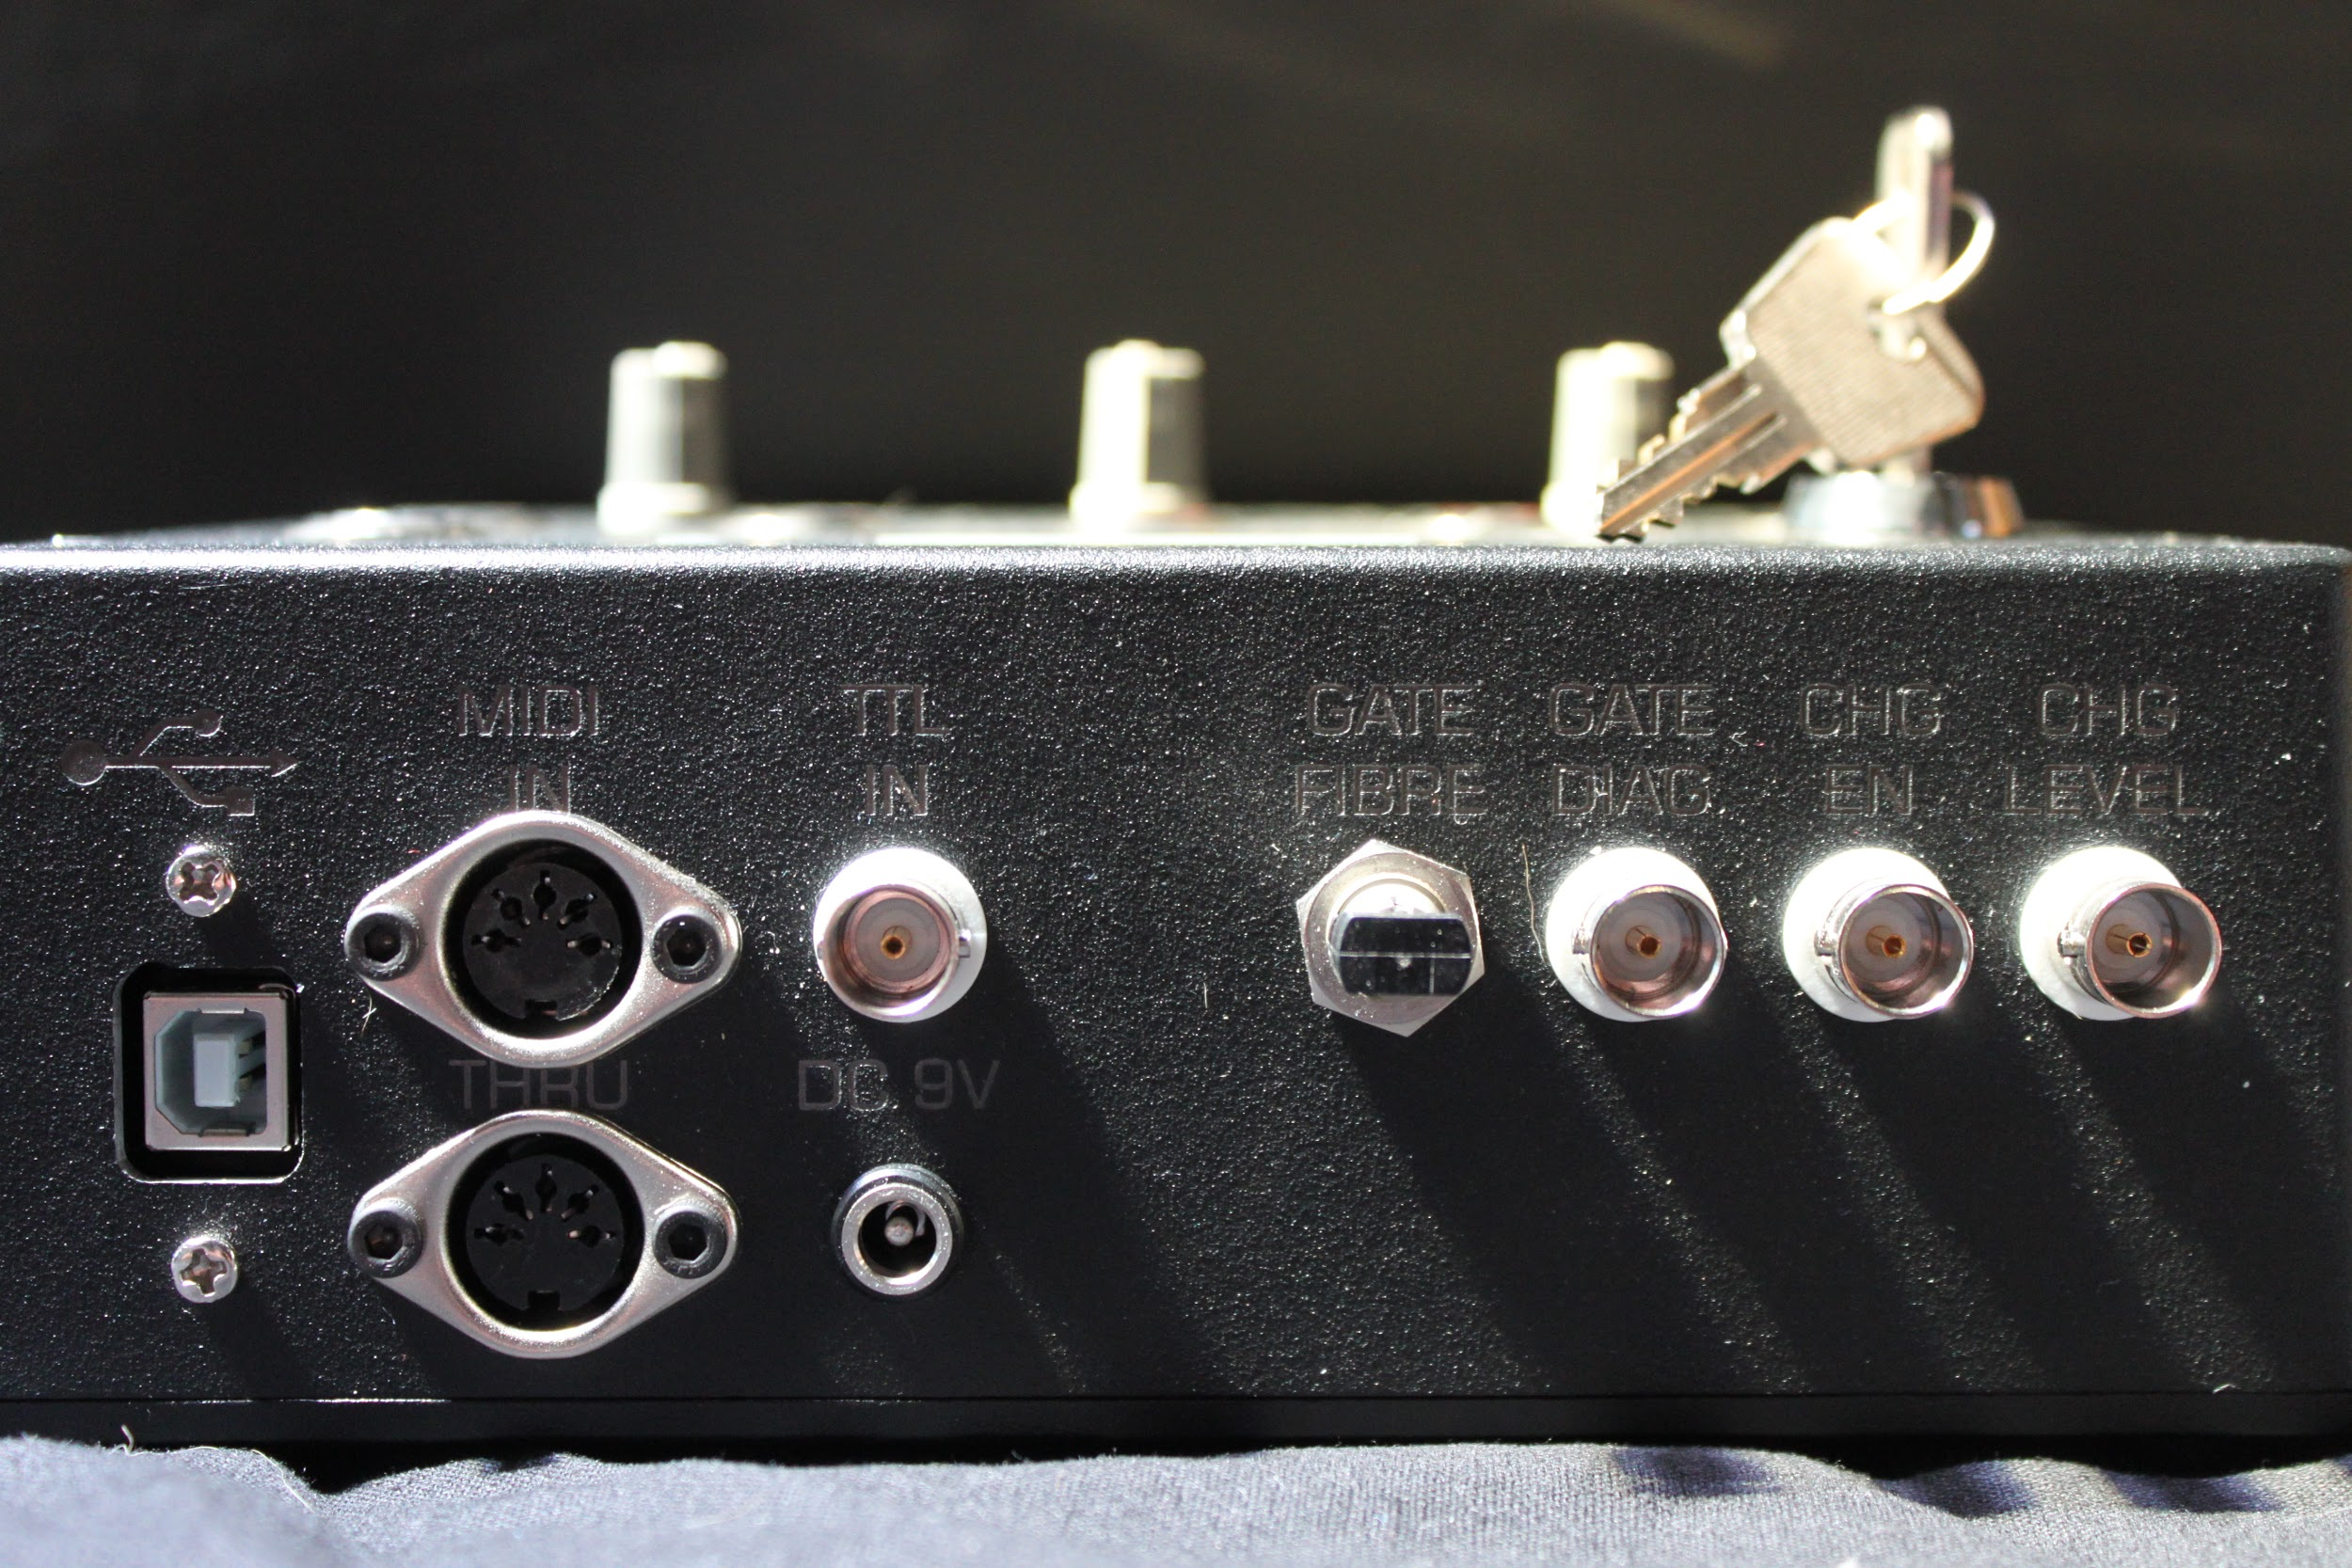
CHIME RED: connectors

Slide 25
Not all jamming is musical
Origin of the name
Coils are horrible interference sources, tend to crash everything in the room
They should be kept caged and grounded

Slide 26
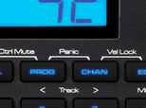
Hanging notes: panic!

Slide 27
Future developments
ICMC 2015 paper
Better DAW integration (easier for musicians)
Multi coil control from same CHIME RED
PCM input (vocoding - making coils talk)

