Slide 1

Through a PRISM, Darkly
Kurt Opsahl
Senior Staff Attorney, EFF

Slide 2
What we’ll talk about today
The Background – History, codenames, spying laws
The Programs – Facts we know about spying under:
  FISAAA and the Patriot Act (PRISM, MARINA)
  Executive Orders (MUSCULAR, BULLRUN)
Fight Back – What we can do to stop the spying

Slide 3
The Background
After 9/11, President Bush unleashed the full power of the NSA
A subset of the President’s Surveillance Program was later labeled the TSP
PSP was without the court-approved warrants ordinarily required for domestic spying
Notes:
The Eye of Sauron unleashed.
TSP was a tautology – defined as the part of the PSP that surveilled terrorists.

Slide 4
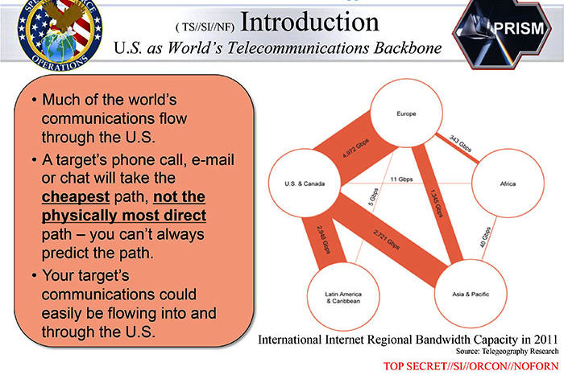
US Companies Sit on Wire
Notes:
The PSP took advantage of being on the wire for most communications – even Asia to Africa would likely go through the United States.

Slide 5
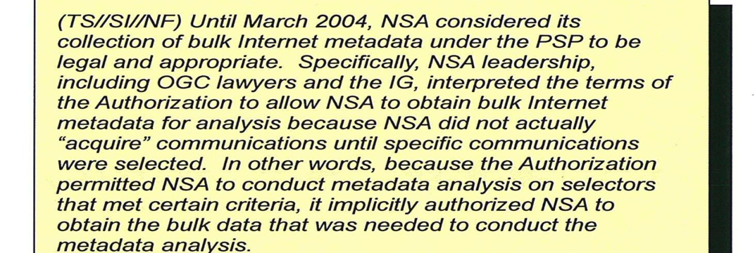
Showdown at the Hospital
March 2004 – Acting Attorney General Comey refused to sign off on the PSP
Gonzales and Comey race to hospital
Threats of resignation
Notes:
Acquisition word game.
Comey says no lawyer would buy this theory. Addington says I’m a lawyer. “No good lawyer.”
Comey is now the FBI Director.

Slide 6
Public Disclosure
2005: NY Times revealed the existence of PSP, focus on content collection
2006: USA Today revealed call-detail records program
2007: Gov’t claims program under FISA court;
  Protect America Act passes
2008: FISA Amendments Act

Slide 7
Know Your Codenames
STELLAR WIND – the original PSP program – has four basic parts:
EVILOLIVE - IP geolocation (1EF)
FASCIA – Location database
 | Content | Metadata
Telephony | NUCLEON | MAINWAY
Internet | PINWALE/ PRISM | MARINA
Notes:
EvilOlive – palindrome, and anagram for I Love Evil. 1EF is one end foreign.
More information in these databases.
"The Marina metadata application tracks a user's browser experience, gathers contact information/content

Slide 8
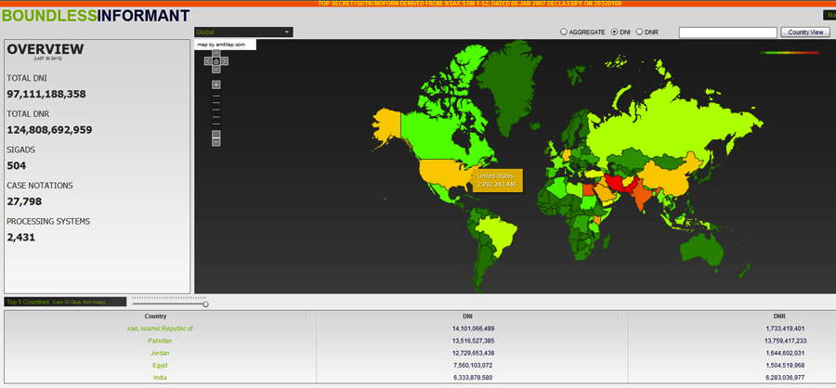
Boundless indeed
Notes:
analysis and data visualization system with records from 504 separate DNR and DNI collection sources (SIGADs).

Slide 9
Know your spying laws
Wiretap Act
Foreign Intelligence Surveillance Act
Electronic Communications Privacy Act
USA Patriot Act (Section 215)
Protect America Act (temporary)
FISA Amendment Act (Section 702)
Executive Order 12333

Slide 10
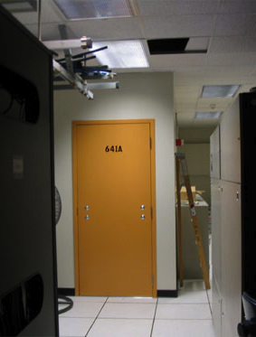
Fiber-Optic Splitters
The “splitter cabinet” splits the light signals in two, making two identical copies of the data carried on the light signal
One copy goes to the NSA
Mark Klein revealed Room
641A of AT&T’s
San Francisco facility

Slide 11
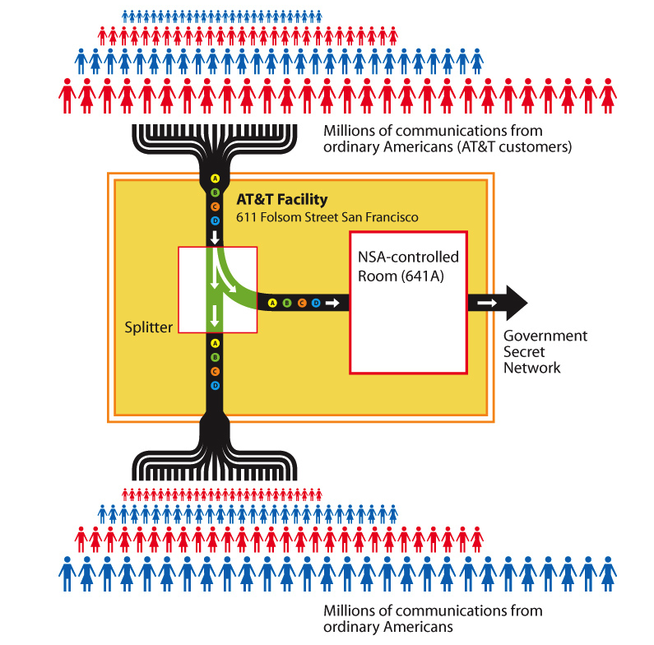

Slide 12
So How Much Is That?
NSA says it only ‘touches’ about 1.6% of the “world’s Internet traffic”
  Only 11.8% of traffic is web, 2.9% comms
    Most is video streaming
    About 2/3 of email is spam
  1.6% is almost 30 petabytes a day
Plus phone calls, call records, location
Notes:
YouTube, Lovefilm, BBC’s iPlayer, NetFlix

Slide 13
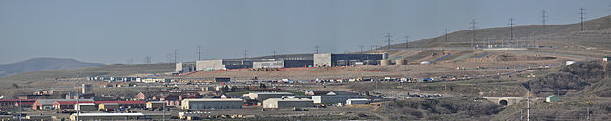
Utah Data Facility
100k ft² (9.2k m²) server space
Estimates between 3 and 12 exabytes
65 to 75 megawatts
Brewster Kahle of the Internet Archive estimates less than 5k ft² (464 m²) to store and process year of just U.S. phone calls
Photo by Swilsonmc CC-BY-SA 3.0 Unported

Slide 14
Data Mining a Haystack
Risen & Lichtblau: Once the communications are acquired, NSA “comb[s] through large volumes of phone and internet traffic” in a “large data-mining operation.”
John Yoo: “pluck out e-mails [and] phone calls that have a high likelihood of being terrorists’ communications.”
Notes:
Risen & Lichtblau – NYT reporters. John Yoo – chief legal architect of Program

Slide 15

Holding without “Collecting”
DNI Clapper: “think of a huge library … To me collection … would mean taking the books off the shelf.”
DNI McConnell: “We may not know that it is in the database until we have some reason to go query that portion of the database.”
Photo by George Chriss CC-BY-SA 3.0 Unported
Notes:
Clapper interview with NBC
McConnell responding on context of question on how much U.S. person data is in the DB.

Slide 16
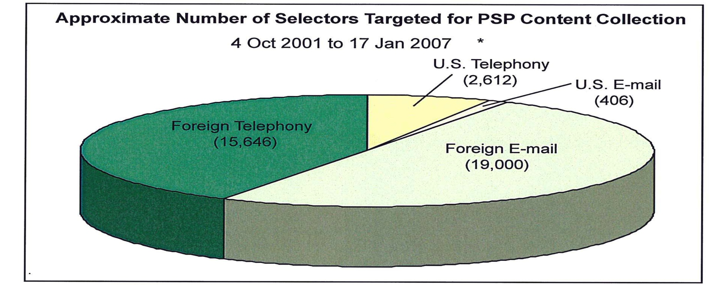
“Target” for “Collection”
Notes:
Collection – word games. Seem like small numbers, but actually quite a lot

Slide 17
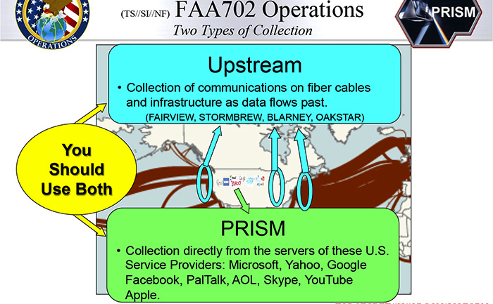
FISAAA 702

Slide 18
FISA Amendments Act
Section 702 was passed in 2008, and the U.S. relies on this for the collection of content
Targeting and Minimization docs
  Targeting 51% chance of foreign
  Assumes foreign unless proved otherwise
  Encrypted information kept forever
  Can turn over U.S. person info in some circumstances

Slide 19
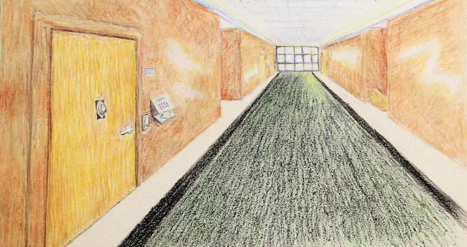
The Secret Court
Notes:
Meets in SCIF. First at DOJ, then at DC district court.

Slide 20
Foreign Intelligence Surveillance Court
Established and authorized under the Foreign Intelligence Surveillance Act
Originally for surveillance against foreign intelligence agents
Role massively expanded
Approves procedures in secret rulings
Notes:
Chief Judge Walton: “The FISC does not have the capacity to investigate issues of noncompliance, and in that respect the FISC is in the same position as any other court when it comes to enforcing [government] compliance with its orders.”

Slide 21
Key Definitions
“United States person”
  US Citizen or permanent resident
  Group with “substantial number of U.S. persons
  U.S. corporation
“Foreign intelligence information”
  Attacks, terrorists, intelligence activity
  OR relates to the “conduct of the foreign affairs of the United States”

Slide 22
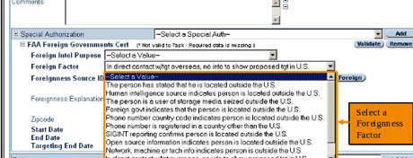
XKeyScore Dashboard:
51% Foreign

Slide 23
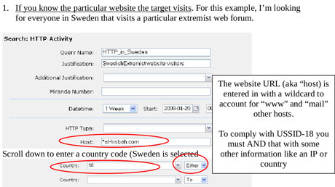
Targeting
Notes:
One selection searches lots of info
NSA looked at any communications that mentioned both the Swedish manufacturer Ericsson and “radio” or “radar”.

Slide 24
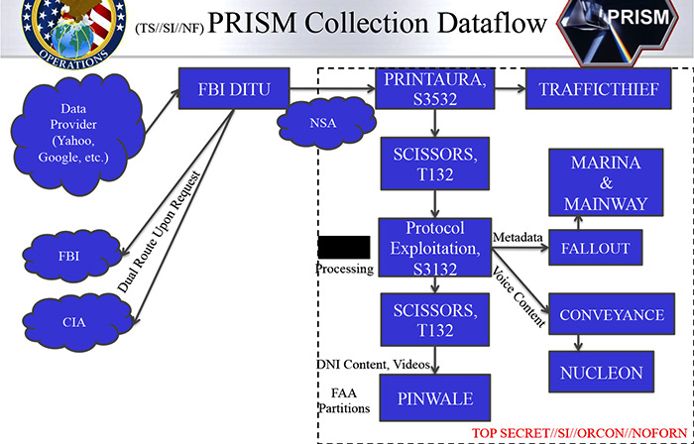
Processing

Slide 25
Section 215 of Patriot Act
Section 215 amended FISA to allow orders to produce “tangible things”
Must be “relevant to an authorized investigation (other than a threat assessment)”
No broader than a Grand Jury Subpoena

Slide 26
Verizon Order
“all call detail records or ‘telephony metadata’ created by Verizon for communications (i) between the United States and abroad; or (ii) wholly within the United States, including local telephone calls.”
Originating and terminating phone nos., IMSI #, IMEI #, trunk identifier, telephone calling card numbers, and time and duration of call
Renewed every 90 days
Notes:
International Mobile Subscriber Identity, International Mobile Station Equipment Identity

Slide 27
Just Metadata
President Obama: “When it comes to telephone calls, nobody is listening to your telephone calls." Instead, the government was just "sifting through this so-called metadata.”
DNI Clapper: “The program does not allow the Government to listen in on anyone’s phone calls. The information acquired does not include the content of any communications or the identity of any subscriber.”

Slide 28
Gov’t Attempts to Explain
No identity
  NSA may have access to phone books
No location information
  “under this program”
Few hundred selectors
  Three hops is a lot of people
Legal basis
  FISA court: analysis until after leaks
  Federal courts split on constitutionality
Notes:
Of course, we later discovery that the NSA is tracking location information, under a different program.
First they said 300, then 200.
First issued gov’t memo, then FISA court opinions.

Slide 29
Why Metadata Matters
They know you rang a phone sex service at 2:24 am and spoke for 18 minutes. But they don't know what you talked about.
They know you called the suicide prevention hotline from the Golden Gate Bridge. But the topic of the call remains a secret.
They know you spoke with an HIV testing service, then your doctor, then your health insurance company in the same hour. But they don't know what was discussed.

Slide 30
Executive Order 12333
Order by U.S. President on how the intelligence community should conduct surveillance
Applies to spying outside U.S. law
Not a substantive limit on surveillance
  “the least intrusive collection techniques feasible within the United States or directed against United States persons abroad”
  “in accordance with procedures”
Notes:
Later amended by Executive Order 13355: Strengthened Management of the Intelligence Community, on August 27, 2004. On July 30, 2008, President Bush issued Executive Order 13470 amending Executive Order 12333 to strengthen the role of the DNI.

Slide 31
Bulk Operations
Phone calls
  70 million French phone calls/month
  60 million Spanish phone calls/month
  NSA Dir. Alexander says French/Spanish intelligence agencies assisted
Financial records from SWIFT
  180 million records in 2011
Notes:
Society for Worldwide Interbank Financial Telecommunication, or SWIFT, is a cooperative owned by around 8,000 financial institutions, runs a messaging service that enables worldwide financial transactions between banks.
Der Spiegel reported that SWIFT was a target of spying by the NSA’s “tailored access operations” division, which collected printer traffic data from numerous banks

Slide 32
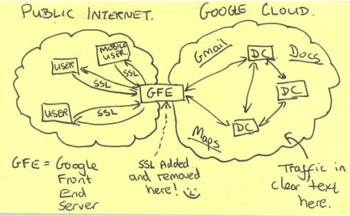
MUSCULAR
Since 2009, NSA infiltrated links between tech company data centers
  Google
  Yahoo
  and more
Works with
UK GCHQ;
routed to Ft.
Meade

Slide 33
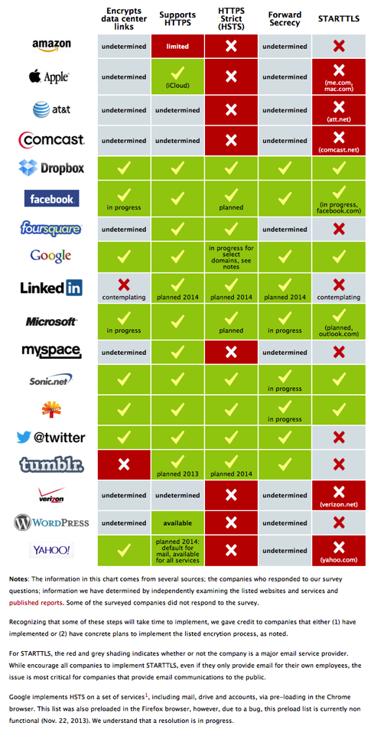
Encrypt All the Bits
Responses to the smiley face
  Dropbox, Facebook, Google, Microsoft, Twitter, Yahoo and others deploying encryption on data center links
  Increased adoption of HTTPS/HSTS
  More forward secrecy
  Full page ads opposing bulk collection

Slide 34
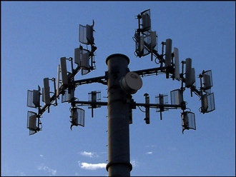
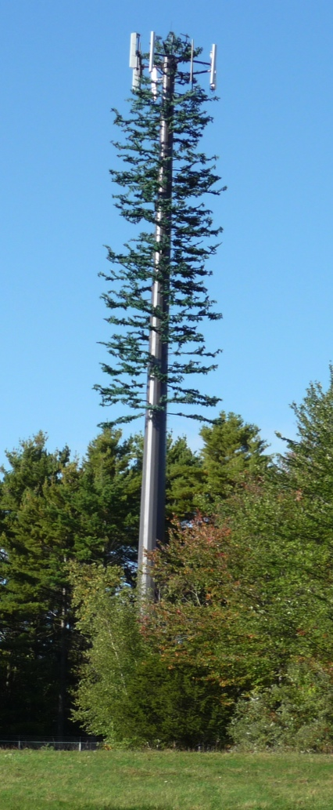
CO-TRAVELLER
The NSA obtains location information from cell tower triangulation, wifi, GPS
Automating guilt by association
  Correlate patterns of movement
  Speed and trajectory
Looking for disposable cellphones
  Switching on, calling, and then switching off
  New phone connects after another phone stops
Notes:
HAPPYFOOT intercepts mobile app traffic that sends a smartphone’s location to ad networks

Slide 35
Targeted Operations
“Special Collection Service”
  Angela Merkel’s cell phone since 2002
  American diplomatic buildings
Spied on at least 35 world leaders
  Mexico, Brazil, senior EU officials
Economic spying
  Petrobras
  2010 Group of 20 summit in Toronto.

Slide 36
The Flying Pig in the Middle
Instead of cracking
SSL: pwn router,
impersonate
certificates
GCHQ operates
FLYINGPIG to
organize SSL
certificates
Notes:
Side note: with codenames like Prism and Flying Pig, suggests that someone in the code naming department is a fan of Pink Floyd album covers.

Slide 37
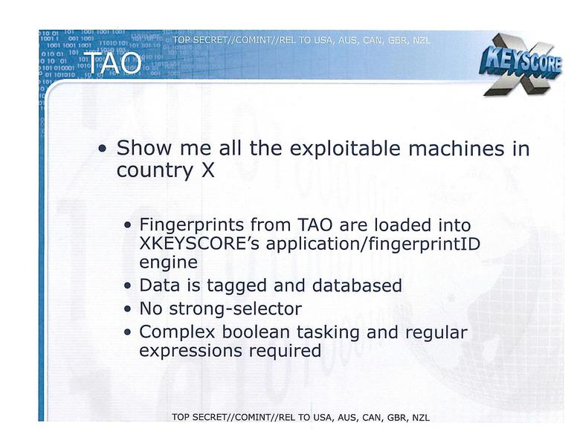
The TAO of the NSA
Office of Tailored Access Operations
231 ops in 2011
  Mexican President’s
  email, OPEC
  Many way to target –
  Google PREF cookies

Slide 38
QUANTUM INSERT
Notes:
Quantum sits on backbone, responds faster than legitimate server (race condition), redirects to FoxAcid server, which serves up malware via Ferret Cannon.
TAO maintains a library of exploits, each based on a different vulnerability in a system. Different exploits are authorized against different targets, depending on the value of the target, the target's technical sophistication, the value of the exploit, and other considerations.

Slide 39
BULLRUN – It’s Sabotage!
$250 million/year program to decrypt
  “Insert vulnerabilities”
  “covertly influence and/or overtly leverage”
  “influence policies, standards and specifications for commercial public key technologies”
    Putting the pseudo in pseudo-random
2010: breakthrough for “vast amounts” of data
Notes:
The name "BULLRUN" was taken from the First Battle of Bull Run, the first major battle of the American Civil War. GCHQ has a similar program codenamed Edgehill, the first battle of the English Civil War.
Dual_EC_DRBG

Slide 40

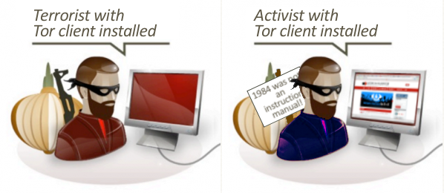
Stinks
Efforts to fingerprint and exploit users via Firefox
  EGOTISTICALGIRAFFE exploits Firefox bugs
  FBI used same technique on Freedom Host (.onion)
Core security appears intact
  No de-anonymizing on demand
Notes:
EgotisticalGiraffe exploits a type confusion vulnerability in E4X, which is an XML extension for Javascript. This vulnerability exists in Firefox 11.0—16.0.2, as well as Firefox 10.0 ESR—the Firefox version used until recently in the Tor browser bundle.
Inadvertently fixed when Mozilla removed the E4X library with the vulnerability

Slide 41
Abuses of Power
Audit found: “2,776 incidents (/year) of unauthorized collection, storage, access to or distribution of legally protected communications” in D.C./Ft. Meade alone
  Misread country code 20 as area code 202 and grabbed all the calls from Washington D.C., instead of from Egypt.
  The “202” area code collection was deemed irrelevant: “The issue pertained to Metadata ONLY so there were no defects to report”
LOVEINT – tracking ex-lovers, spouses
Notes:
NSA Dir. Alexander told Blackhat that there was no one who went outside the bounds. Domestically.
10 incidents of LOVEINT – self reported. Overseas.

Slide 42
Discrediting Radicalizers
The NSA is gathering evidence of “radicalizer’s” visits to porn sites
  Also “online promiscuity” and “deceitful use of funds”
“Radicalizers” are people who speak on their “extremist” views online
  Seeking to discredit the message

Slide 43

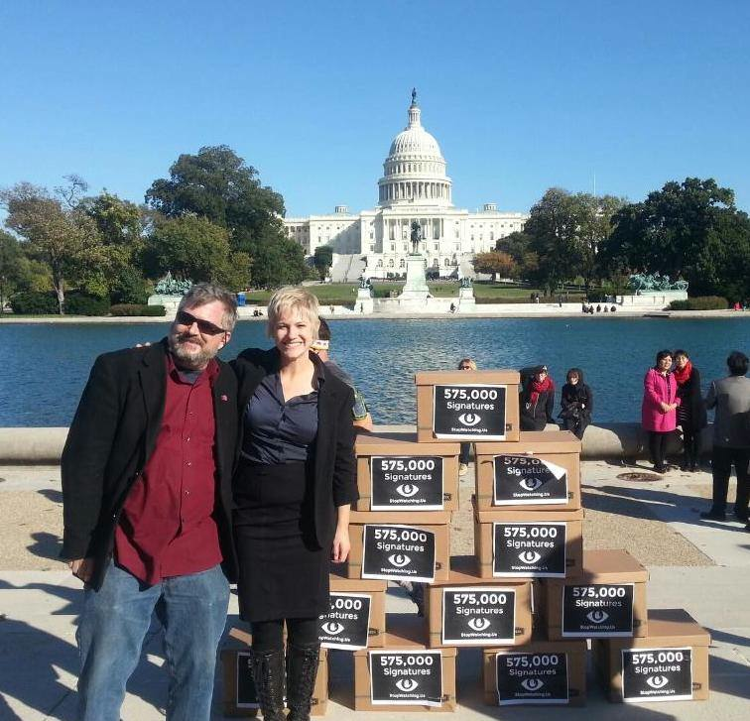
Legislation and Activism
Built broad coalition
  Over half-million petition
  signatures to U.S. Congress
  Interpret for public
Commenting on U.S. bills
    Feinstein/Rogers
    Leahy/Sensenbrenner

Slide 44

International
13 Principles (necessaryandproportionate.net)
  Over 300 organizations worldwide
  Basis for UN Resolution
    You can sign!
Legal processes
  ECHR complaint; OAS hearing
Notes:
Privacy International has submitted a claim to the UK Investigatory Powers Tribunal (IPT) European Convention on Human rRghts
The Inter-American Commission on Human Rights, Organization of American States (OAS), held a hearing on October 28, 2013 on the NSA's mass surveillance and its impact on human rights in the Americas. The hearing was held at the request of the American Civil Liberties Union, and included the U.N. Special Rapporteur on Freedom of Opinion and Expression, Frank La Rue.

Slide 45

Technology
Still to be done: Ease of use
  End-to-end in phones, IM, text messages
  Securify the interwebs, social networking, disk drives, flash memory, “data at rest”
Shore up crypto tools against sabotage

Slide 46
You
Pay attention, Share, Vote
  Activism is an open source project
Use the tools – “I am Spartacus”
Build the tools for a future you would want to live in

Slide 47
Questions?
Kurt Opsahl
Senior Staff Attorney, EFF
@kurtopsahl
kurt@eff.org
More info at https://eff.org/nsa-spying

