Slide 1
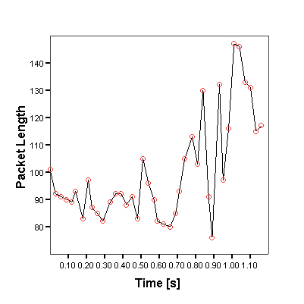
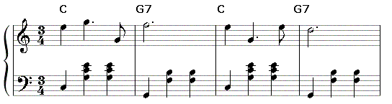
Encrypted Traffic Mining (TM) e.g. Leaks in Skype
Benoit DuPasquier, Stefan Burschka

Slide 2

Contents
Who, What (WTF), Why
Short Introduction 2 TM
Engineering Approach
TM Signal Analysis Methods
Results
Questions

Slide 3






Who: Since Feb 2011 @
Sakir, Benoit, Antonio
Ulrich, Ernst, ...
Nur & Malcolm
Stefan
Wurst
Francesco
Torben
Sebastian
Antonino
Fabian
Mischa
Noe
ﺤﺮﺐ
© NASA
?
© Rouxel
Antonio, Patrick, Hugo, Pascal, K-Pascal, Mehdi, Javier, Seili, Flo, Frederic, Markus, ...
Dago
© Rouxel

Slide 4
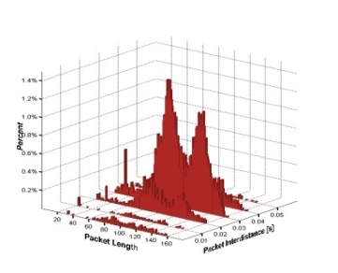
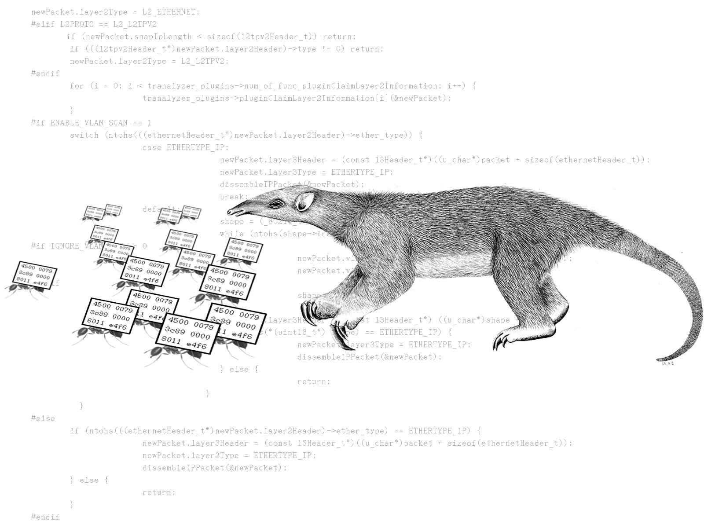
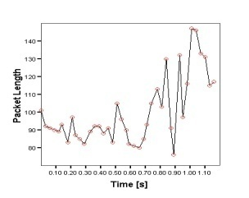
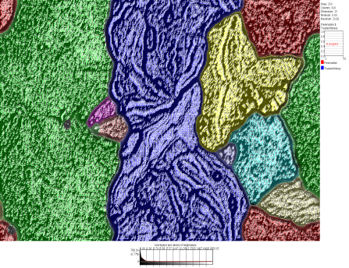
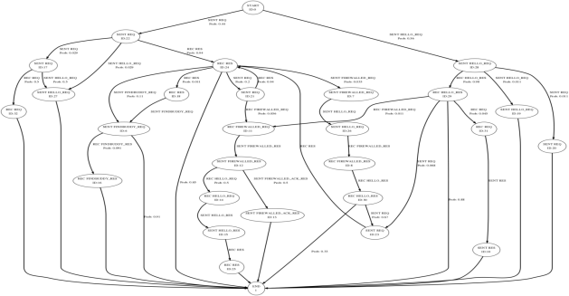
What: Apollo Projects
Network Troubleshooting:
    NINA: Automated Network Discovery and Mapping
    TRANALYZER: High Speed and Volume Traffic Flow Analyzer
    TRAVIZ: Graphic Toolset for Tranalyzer
  Operational Picture:
  How to understand Multidimensional Data?
  Automated Protocol Learning and Statemachine reversing

Slide 5
WTF is in it?

Slide 6
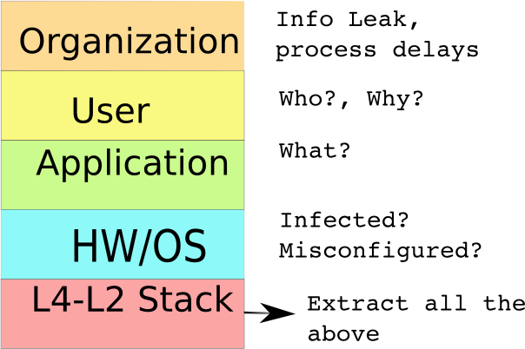
Traffic Mining:
Hidden Knowledge: Listen | See, Understand, Invariants ➔ Model
Application in
  Security (Classification, Decoding of encrypted traffic )
  Netzwerk usage (VoiP, P2P traffic shaping, skype detection)
  Profiling & Marketing (usage performance- & market- index)
  Law enforcement and Legal Interception (Indication/Evidence)

Slide 7
Traffic Mining:
Encrypted Content Guessing
  SSH Command Guessing
  IP Tunnel Content Profiling
  Encrypted Voip Guessing: e.g. Skype

Slide 8
If you plainly start listening to this
22:06:51.410006 IP 193.5.230.58.3910 > 193.5.238.12.80: P 1499:1566(67) ack 2000 win 64126
0x0000: 0000 0c07 ac0d 000f 1fcf 7c45 0800 4500 ..........|E..E.
0x0010: 006b 9634 4000 8006 0e06 c105 e63a c105 .k.4@........:..
0x0020: ee0c 0f46 0050 1b03 ae44 faba ef9e 5018 ...F.P...D....P.
0x0030: fa7e 9c0a 0000 28d8 f103 e595 8451 ea09 .~....(......Q..
0x0040: ba2c 8e91 9139 55bf df8d 1e07 e701 7a09 .,...9U.......z.
0x0050: cf96 8f05 84c2 58a8 d66b d52b 0a56 e480 ......X..k.+.V..
0x0060: 472d e34b 87d2 5c64 695a 580f f649 5385 G-.K..\diZX..IS.
0x0070: ea31 721f d699 f905 e7 .1r......
Header
Payload
You will end like that

Slide 9
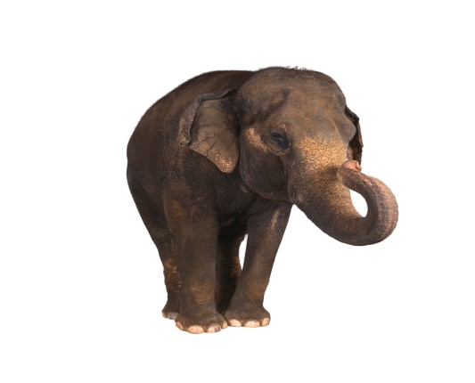
Distinguish from by listening
So, what is the Task?
Gap in tracks
Sound ~
Packet Length
Packet Fire Rate
(Interdistance)

Slide 10
Why Skype?
EPFL
Google Talk, SIP/RTP, etc too easy
At that time many undocumented codecs, including SILK
Challenge: Constant packet flow, so no indication about speaker pause
Feds: Pedophile detection in encrypted VoIP

Slide 11
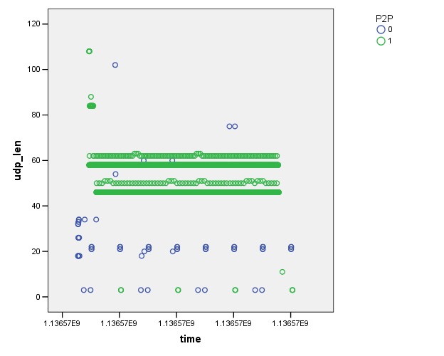
TM Exercise: See the features?
Codec training
Burschka (Fischkopp) Linux
Dominic (Student) Windows
SN
Ping min l =3

Slide 12
Hypotheses
Existence of Transfer Function between audio input and observed IP packet lengths
Output is predictable
Given the output, input can be estimated

Slide 13
Parameters influencing IP output
Basic signals (Amplitude, Frequency, Noise, Silence)
Phonemes
Words
Sentences

Slide 14
Assumptions
Everybody uses Skype
Only direct UDP communication mode, Problem already complicated enough
Language: English

Slide 15
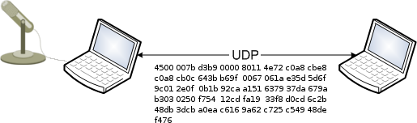
Basic Lab setup
MS Windoof XP Pro Ver 2002 SP3
Intel(R) Core(TM) 2
E6750 @ 2.66 GHz 2.99 Gz
RAM 2.00 GB
Skype Version 4.0.0.224
Skype’s audio codec SILK
Phonem DB from Voice Recognition Project with different speakers

Slide 16
1. Engineering Approach:
Influencing Parameters
Audio codec is invariant component
Skype’s internal (cryptography, network layer)
Sound cards
Software being used to feed voice into Skype
Software being used to generate sounds.

Slide 17
Derive the Transfer Function
H

Slide 18
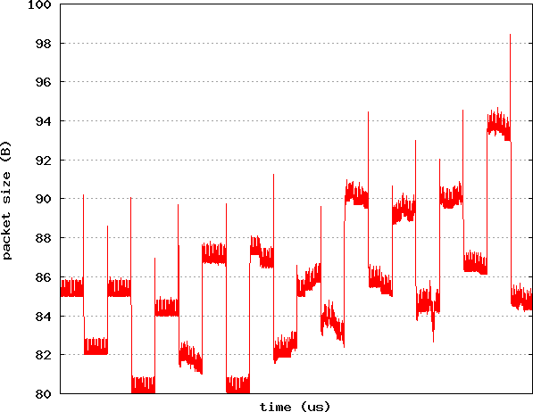
Example: Frequency sweep

Slide 19
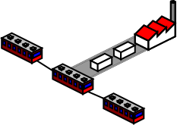
Result: Skype Transfer Model
Desync packet generation process and codec output
codec
Speeds unsyncronized
Ip layer

Slide 20
2. Mining Approach
Engineering approach inappropriate, model too complex
So Voice to Packet generation process has to be learned
Find mapping:
  Phonems
  Words
  Sentences
Produce Invariants

Slide 21
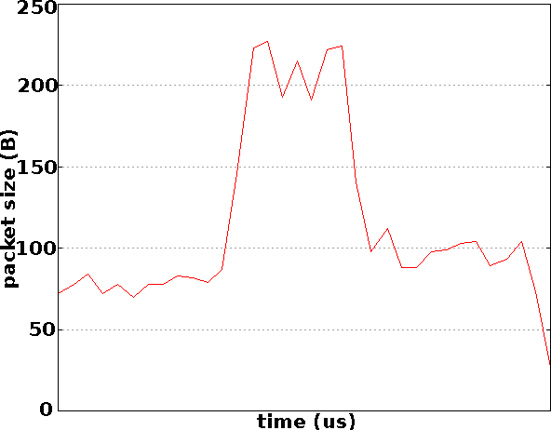
Attack, Comb, Decay, Sustain, Release
Phoneme / /, e.g. in word pleasure
Find Homomorphism between 44 Phonems
Commutativity f (a * b) = f (b * a)
Additivity f (a * b) = f (a) * f (b)

Slide 22
Results: Signal Invariant Analysis
No satisfying Homomorphism except in Signal Length and Silence / Signal
Word construction difficult due to phoneme overlapping
Noise / Silence estimation & substraction improves results considerably
The longer the sequence, the better the results
→ Sentences Detection

Slide 23
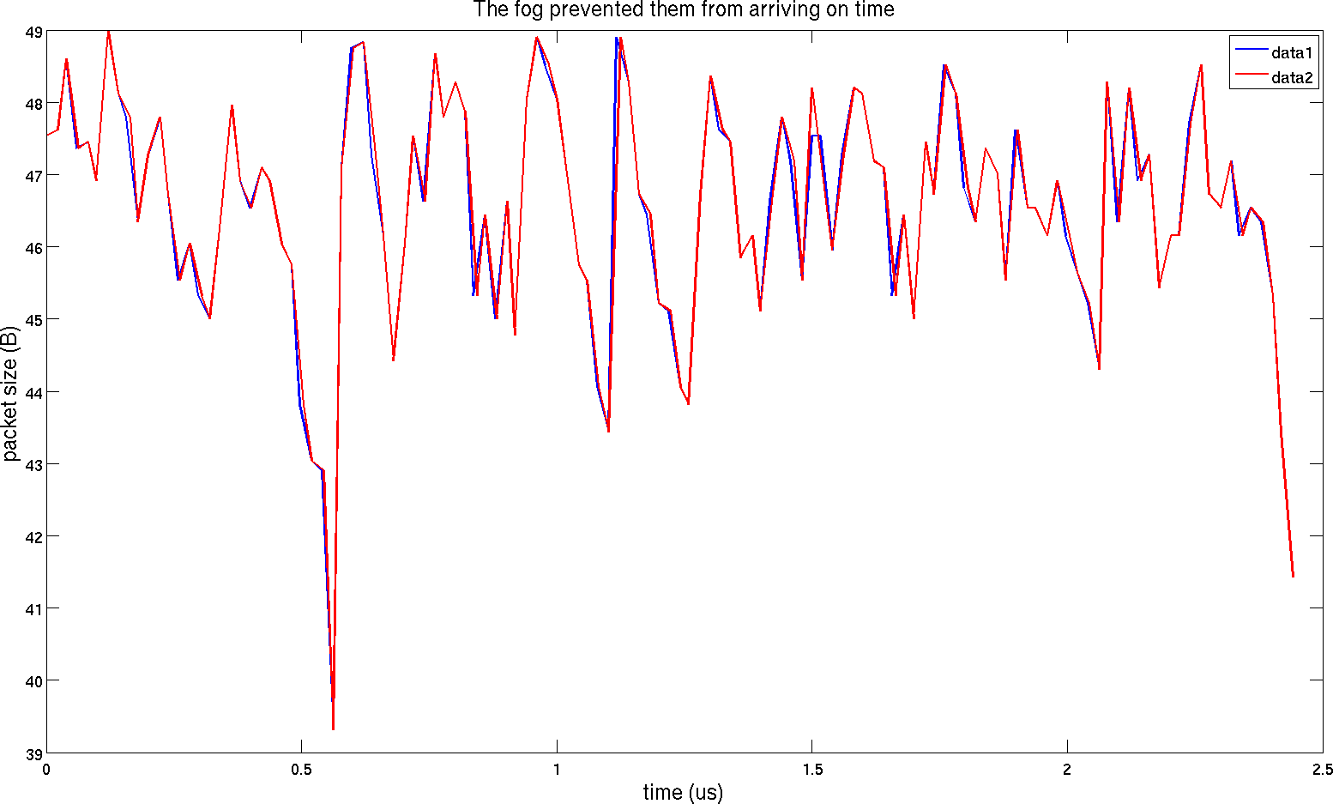
Sentence Signals
Same sentences, similar output → ☺

Slide 24
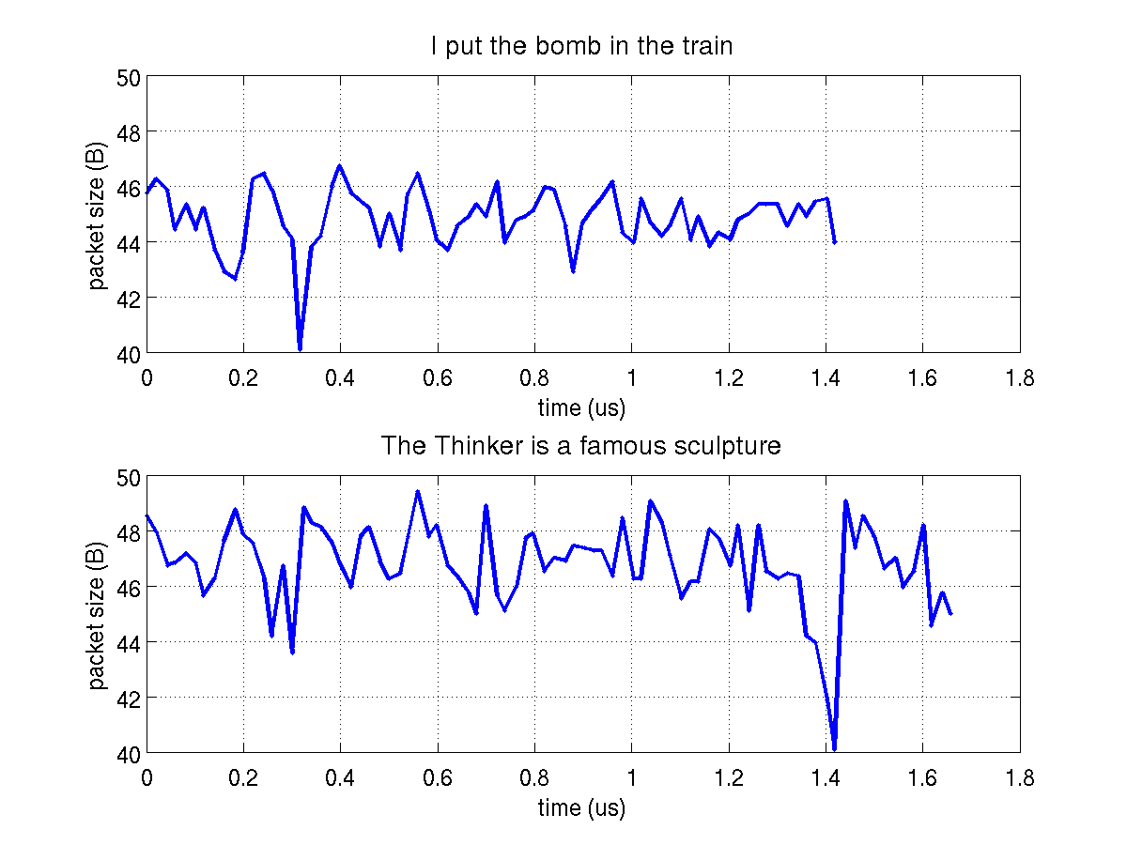
Different Sentences same Speaker
☺

Slide 25
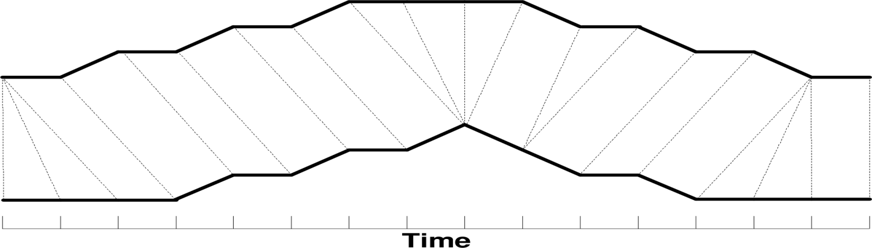
Signal Differentiation:
Dynamic Time Warping (DTW)
Dynamic programming algorithm, Predecessor of HMM
Mainly used for speech processing
Suited to compare sequences varying in time or speed
Squared euclidian distance
Visualization of similarity DTW map

Slide 26
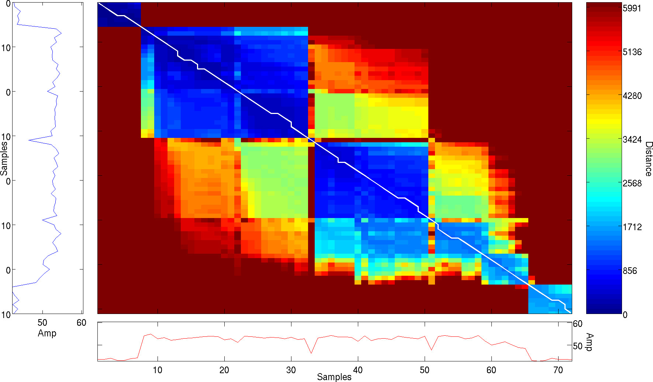
Matching DTW map path
Optimal Path
Young children should avoid exposure to contagious diseases

Slide 27
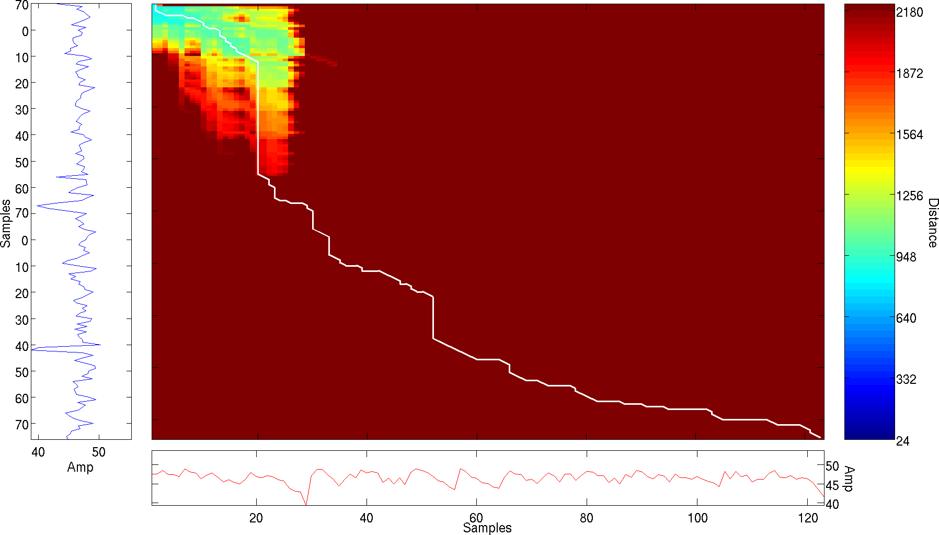
Non-matching DTW map path
The fog prevented them from arriving on time
Young children should avoid exposure to contagious diseases

Slide 28
Results: Speaker dependent
Six Recordings: Permutation of three sentences
Nine target sentences, one model per sentence
  66% of correct Classification
Mis-classification: “I put the bomb in the train”
“I put the bomb in the bus”
Eight target sentences, several models per sentence
  83% of correct guesses

Slide 29
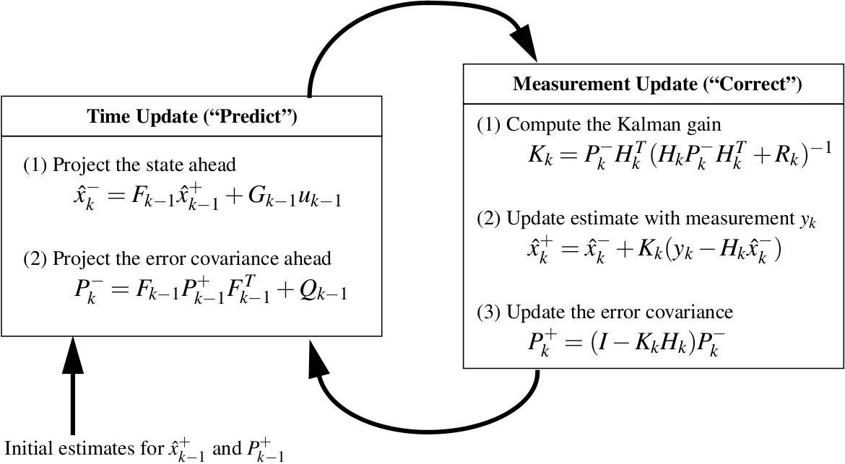
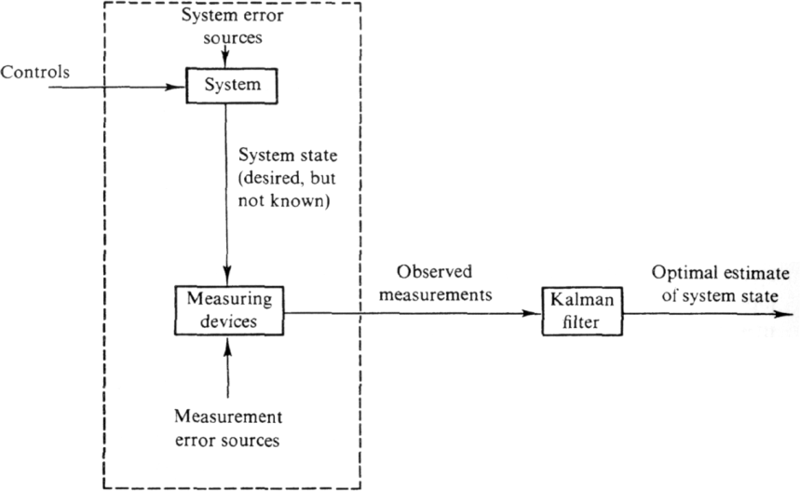
Noise & Speaker Resilience
The Kalman Filter (‘60ies)
Recursive linear filter
Mainly used for radar or missile tracking problems
Estimates state of linear discrete-time dynamical system from series of noisy measurements (If non-linear: use 1. order Taylor term)
Process & measurement noise must be additive and gaussian
© Greg Welsh, Gary Bishop
Our case: k = 0 ➔ F,H,Q,R const in time

Slide 30
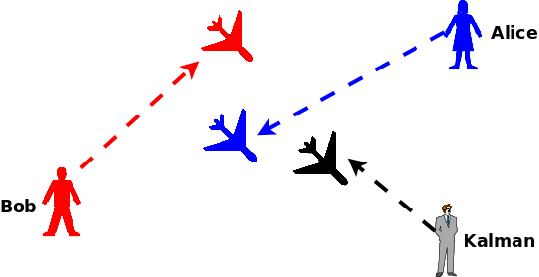
Kalman Filter Functionality
Average Estimator, Predictor
X,t1
Y,t2
Z,t3
Position of Alice and Bob not known
  Bob: At time t1 plane at position X
  Alice: At time t2, the plane is at position Y
Kalman Filter: Prediction of next plane position
  At time t3, the plane will be at position Z

Slide 31
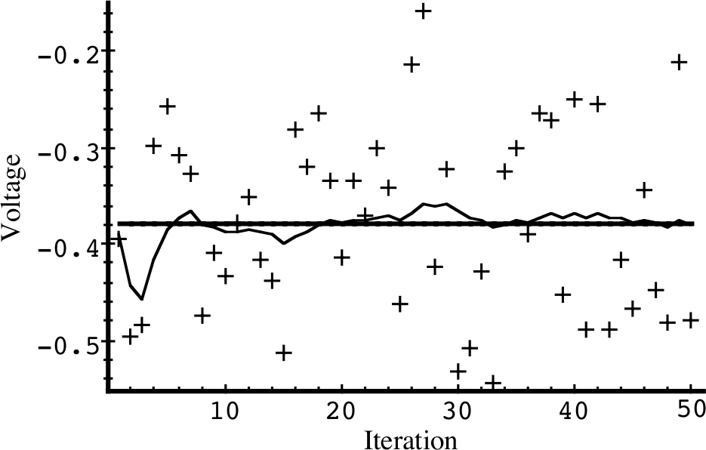
Example: Constant Line Estimation
Data
Estimation Goal
Kalman Filter Estimation

Slide 32
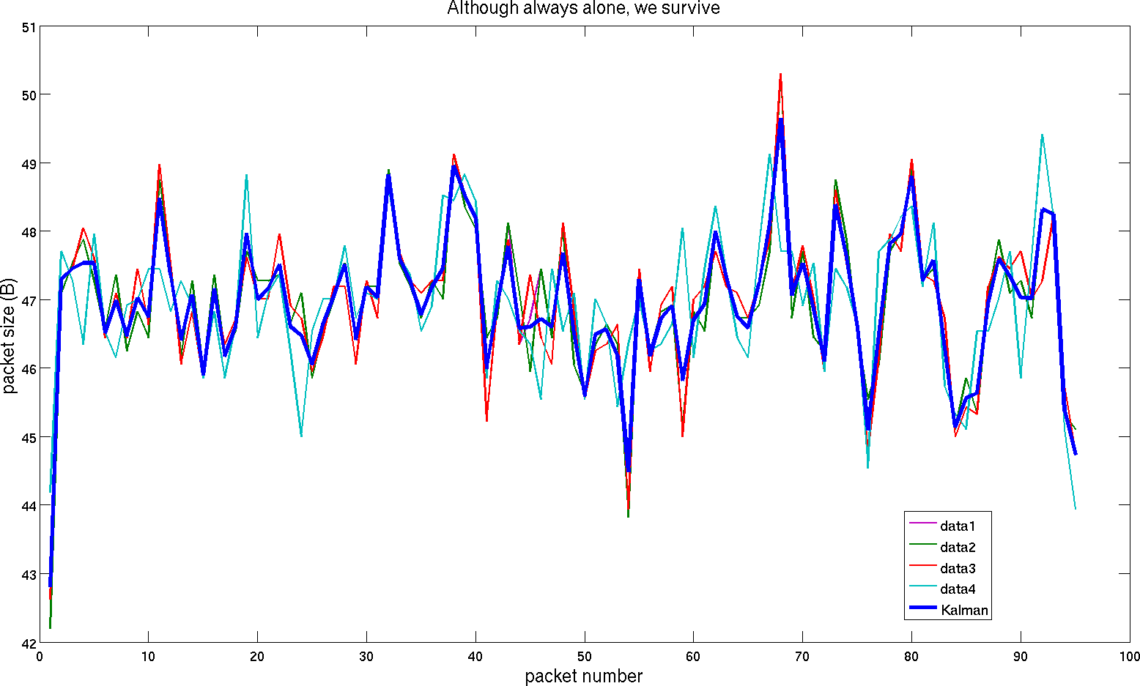
Kalman Model for one Sentence

Slide 33
Mitigation Techniques
No perfect solution
  Trade-offs between bandwidth consumption, computational power and information leakage required
Padding at the cryptographic layer
  Pad each packet to bit position length, e.g., 58 → 64 Bytes
  Computational acceptable
Add random payload to network layer
  Random payload of random size
  New header field required
  Computational expensive

Slide 34
Conclusions
Detection of a sentence in Skype traces is possible
  Q&D: With an average accuracy greater than 60%
  Can reach 83% under specific conditions
Kalman Filter: Speaker independent models
Mitigation techniques: Relatively easy
Invest more work ➔ better results: s. USA 2011

Slide 35
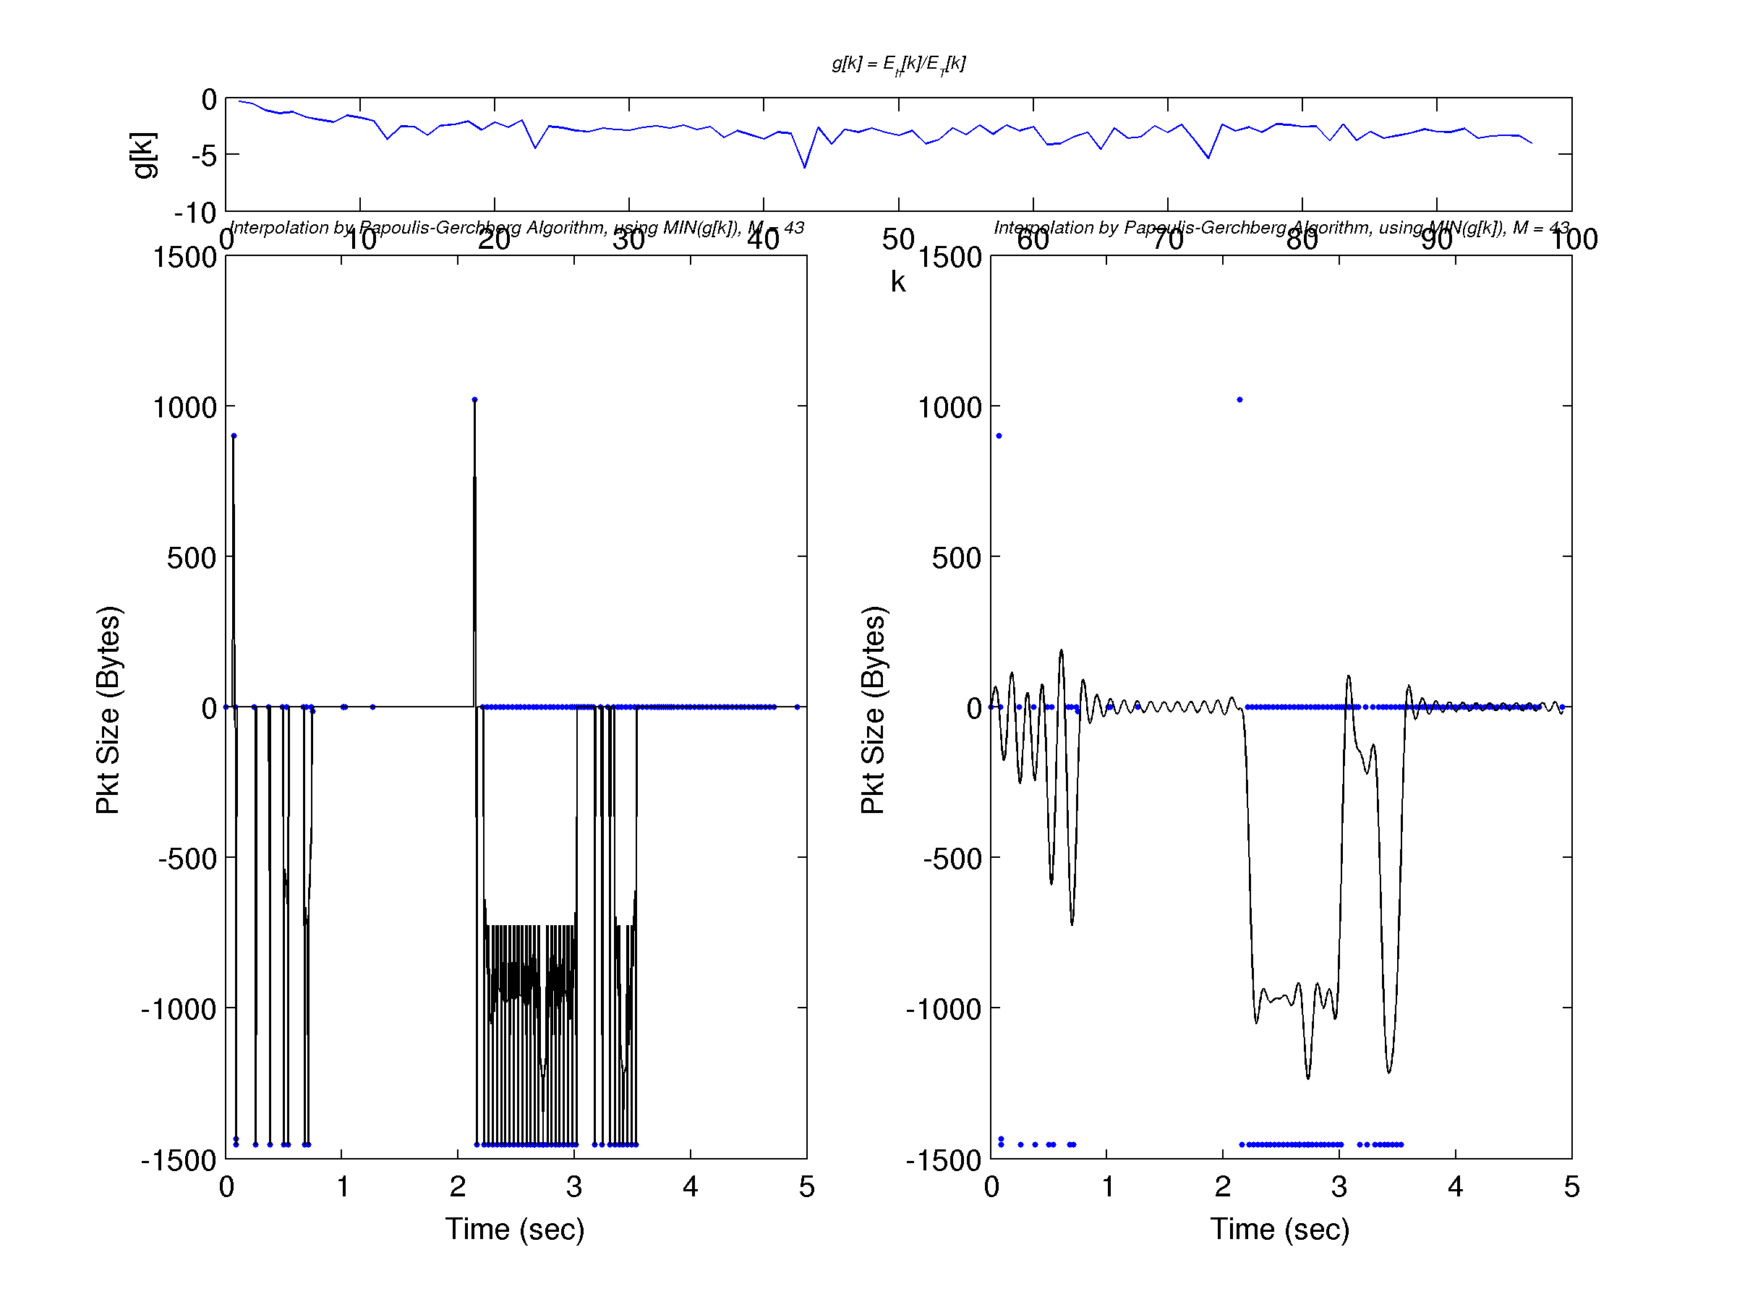
Next: All IP Signal Processing

Slide 36
Questions / Comments
Science is a way of thinking much more than it is a body of knowledge.
Carl Sagan
V0.57
http://sourceforge.net/projects/tranalyzer/
stefan.burschka@ruag.com

